Slide 1
Final Presentation
Group 6 - GreenAR World
Notes:
Alex

Slide 2
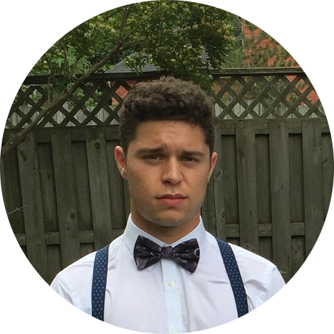
Our Team
Alexander Fournier BASc. Chemical Engineering
Monica Harada BASc. Electrical Engineering
Branden Leung BASc. Electrical Engineering
Keera Moretti BASc. Chemical Engineering
Ethan Leung BASc. Electrical Engineering
Notes:
Alex

Slide 3
Our Mission
Reduce the amount of landfill waste by educating and promoting proper recycling practices
Notes:
Alex

Slide 4
Problem Statement
A need exists for the general public to develop better recycling habits
Utilize a simple and intuitive way
Give proper recycling instructions about any disposable item
Must be cost effective and follow proper recycling regulations according to the City of Ottawa.
Notes:
Alex

Slide 5
Consequences of Improper Recycling
Misplacement of waste into the incorrect bins
Resulting in inefficient recycling and overflow of landfills
Upwards of 25% of the waste put in recycling bins is also rendered non-recyclable by contamination (food contaminants or other materials) [1]
Canadians are throwing too much garbage into the wrong bins out of laziness, ignorance or lack of knowledge [2]
Notes:
Branden

Slide 6
Product of Improper Recycling
Canada alone produces approximately 5 million metric tonnes of plastic waste each year [3]
86%
Landfills
9%
Recycled Plastic
4%
Incinerators
1%
Litter that can contaminate lakes and oceans
Notes:
Branden

Slide 7
Proposed Solution
Create an application that can analyze and categorize garbage/recyclable items
Utilize AR in the application to recognize items
Give users clear, easy to follow instructions for disposal
Give users a fun element by applying rewards system
31.38 million smartphone users in Canada [4]. Clear market for improving recycling habits nationwide
The more users, the potential decrease in improper recycling and landfill waste
Application is free and user-friendly
Notes:
Branden

Slide 8
Design Process
Problem, Design Criteria, Conceptual Design
Prototype 1
Prototype 2
Prototype 3
Final Product
Identified client needs, benchmarking, target specifications, concept development
Established introduction & AR recognition
Addition of settings, information, rewards screen, image targets
Full implementation of all screens & additional image targets
Minor adjustments made to Prototype III
Notes:
Branden

Slide 9
Conceptual Design
Implementation of 5 subsystems/screens
Introduction Screen
Main Screen
Setting Menu
Information Screen
Rewards Menu
Easily able to navigate app
Rewards system to motivate use
Notes:
Monica

Slide 10
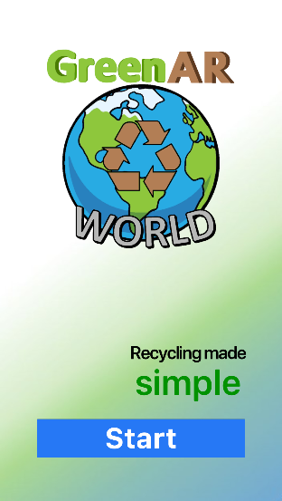
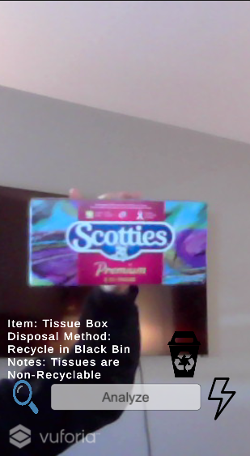
Prototype I
Created introduction screen
Started by testing and implementing AR object recognition
Flash and search toggles functional
Displayed recycle information on main screen
Notes:
Monica

Slide 11
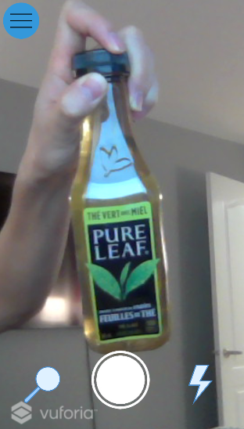
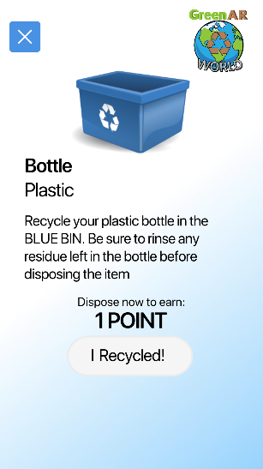
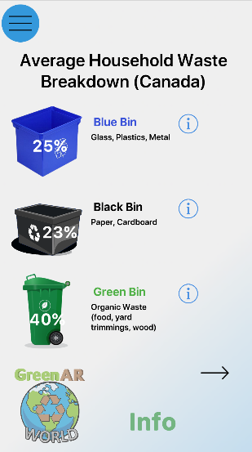
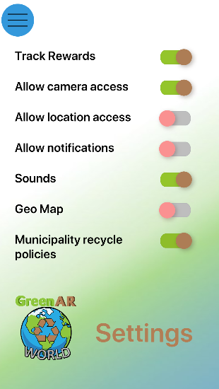
Prototype II
Added more image targets
Redirects user to another screen to show recycling instructions
Collapsable menu
Developed multi-page information menu
Created settings menu
Improved aesthetics
Notes:
Monica

Slide 12
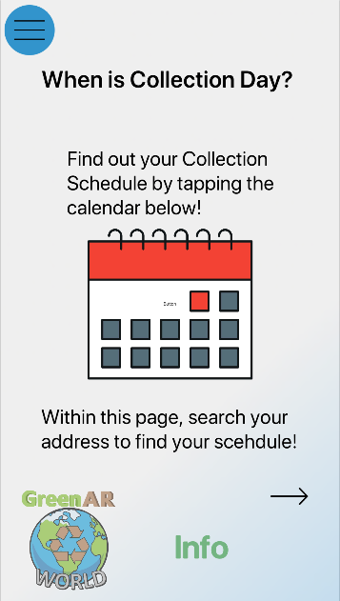
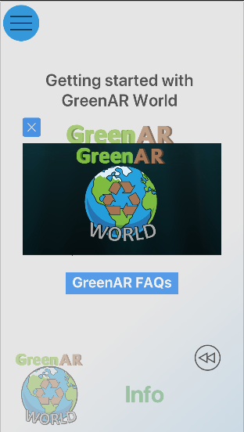
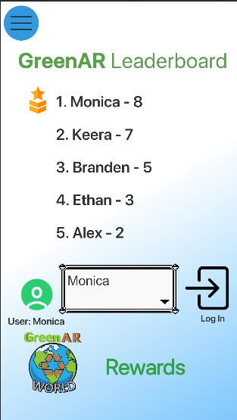
Prototype III
Added more image targets
Added collection day link within information menu
Added tutorial video and FAQ within information menu
Functioning recycle point collection system
Created functioning leaderboard system
Notes:
Monica

Slide 13
Live Demo
Application Run Through (Final Product)
Notes:
Ethan

Slide 14
Team Management (Project Plan)
How were we so successful?
Utilize Wrike, a project management software to divide work up evenly
Meeting important deadlines to keep everyone on track and moving forward
Constant communication via facebook, messenger, and zoom to ensure all members are on the same page.
Problem solving together and ensuring everyone agrees with the direction the project is headed
Notes:
Alex

Slide 15
Prioritization of Consequences and Issues
Rank | Issues | Constraints
1 | Not being able to collaborate in person | Everything is virtual and hard to convey
2 | Limited number of image targets | Will not be able to recognize every single waste object
3 | Not able to finish all the details or look into more advance recognition systems | Time constraint of 3 months
4 | Embedded URL Icons | Leave the application to access URL
5 | Settings Options | Implementation Redundant for what we have
6 | Flawed Leaderboard system | Full concepts from original design are not realized
Notes:
Alex

Slide 16
Lessons Learned
Unity
Team Communication
Wrike
User Interface
Design Process
Prototype Testing
How to utilize software and create an app
Consistent communication and division of works
Project planning, staying organized, on task, and on schedule
In creating app, realized importance of user friendliness. Every small detail matters
Come up with an idea and figure out the steps to creating final product
Testing each prototype to see what needs to be fixed/debugged
Notes:
Keera

Slide 17
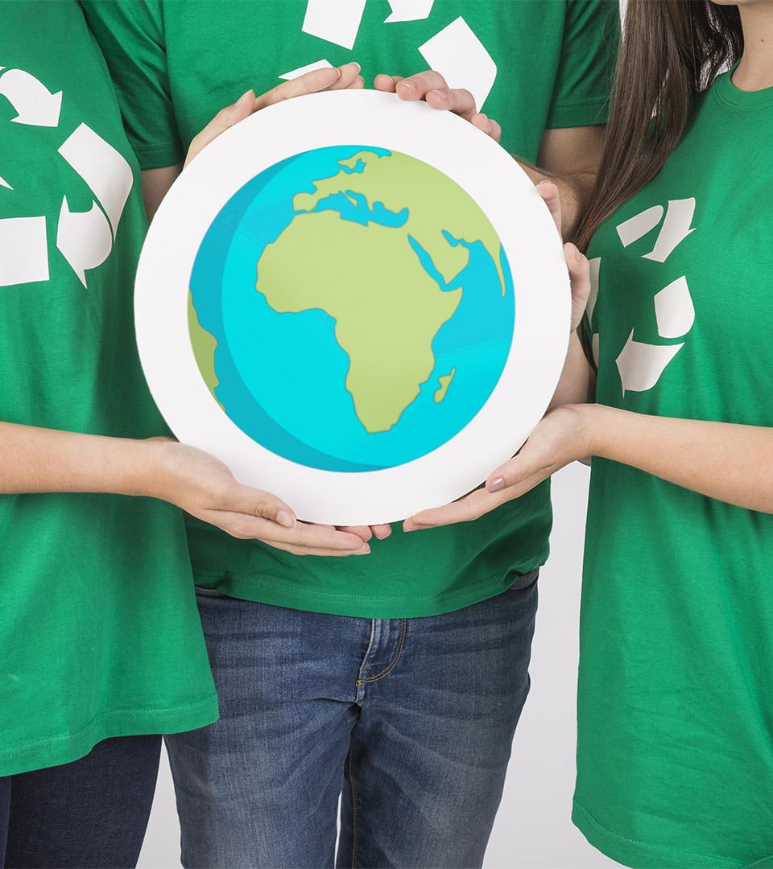
Future Works
Publication of application
Implementing physical prize incentives
Able to detect 90% of image targets
Implementation of Geo-Map for location of different recycle bins
Notes:
Keera

Slide 18
Conclusion
Ultimate goal
Created a user friendly app to promote proper recycle habits
Leads to reduced landfill waste
Raises awareness about improper recycling
Functional product
Good first step to creating app to be utilized by the City of Ottawa
Notes:
Keera

Slide 19
Thank You For Your Time
Any Feedback or Questions?
Notes:
Keera

Slide 20
References
[1]
C. Attie, “Why your recycling may not actually get recycled | CBC Radio,” CBCnews, 02-May-2019. [Online]. Available: https://www.cbc.ca/radio/sunday/the-sunday-edition-for-april-21-2019-1.5099057/why-your-recycling-may-not-actually-get-recycled-1.5099103. [Accessed: 31-Mar-2021].
[2]
E. Chung, “Many Canadians are recycling wrong, and it's costing us millions | CBC News,” CBCnews, 09-Apr-2018. [Online]. Available: https://www.cbc.ca/news/technology/recycling-contamination-1.4606893. [Accessed: 01-Apr-2021].
[3]
“Canada recycles just 9 per cent of its plastics,” Recycling Council of Ontario, 06-Dec-2019. [Online]. Available: https://rco.on.ca/canada-recycles-just-9-per-cent-of-its-plastics/. [Accessed: 31-Mar-2021].
[4]
P. by S. O'Dea and D. 7, “Smartphone users in Canada 2018-2024,” Statista, 07-Dec-2020. [Online]. Available: https://www.statista.com/statistics/467190/forecast-of-smartphone-users-in-canada/. [Accessed: 02-Apr-2021].

Slide 21
Backup Demo
Notes:
Ethan

