Slide 1
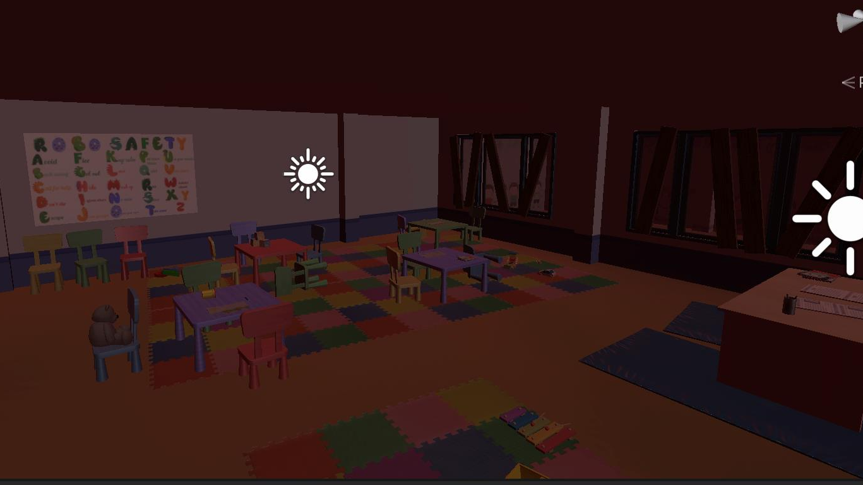
GNG 1103-VR project (kindergarten Classroom after autonomous weapons)
Group 7

Slide 2
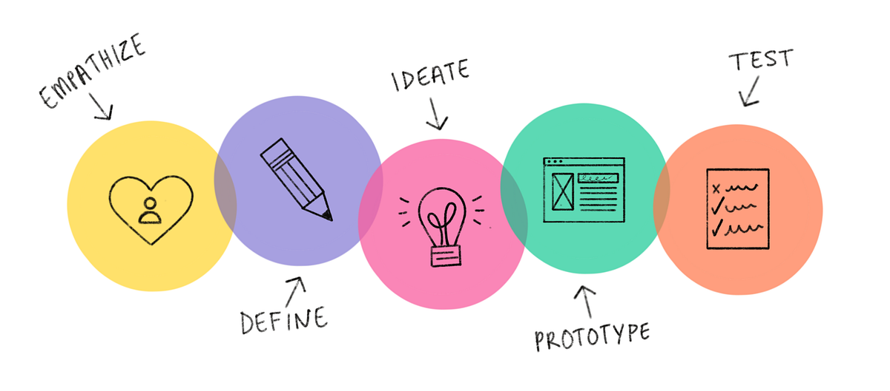
Design process

Slide 3
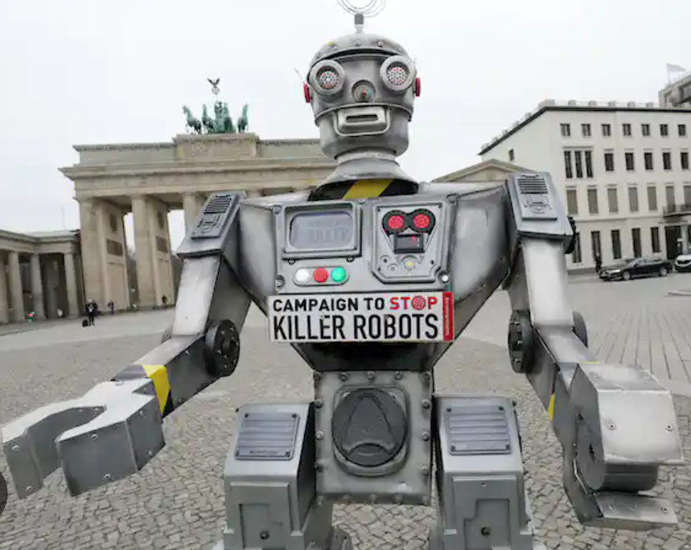
Empathize

Slide 4
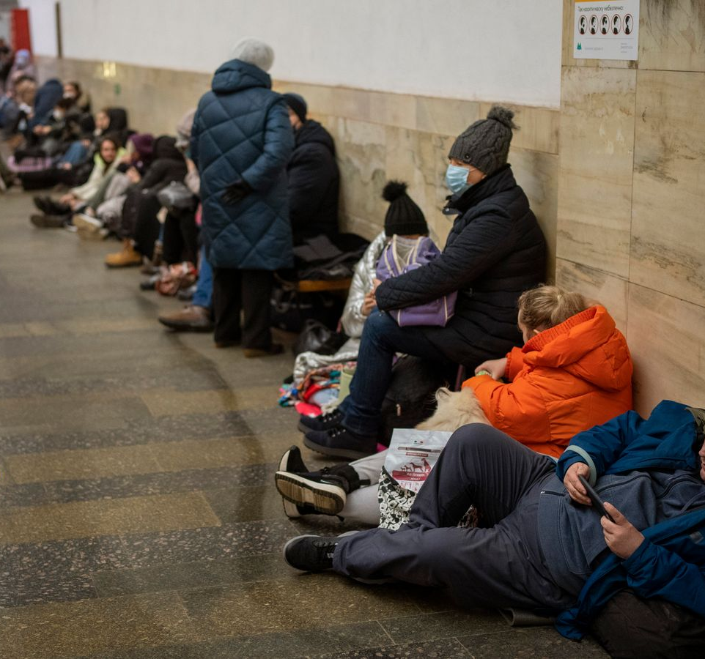
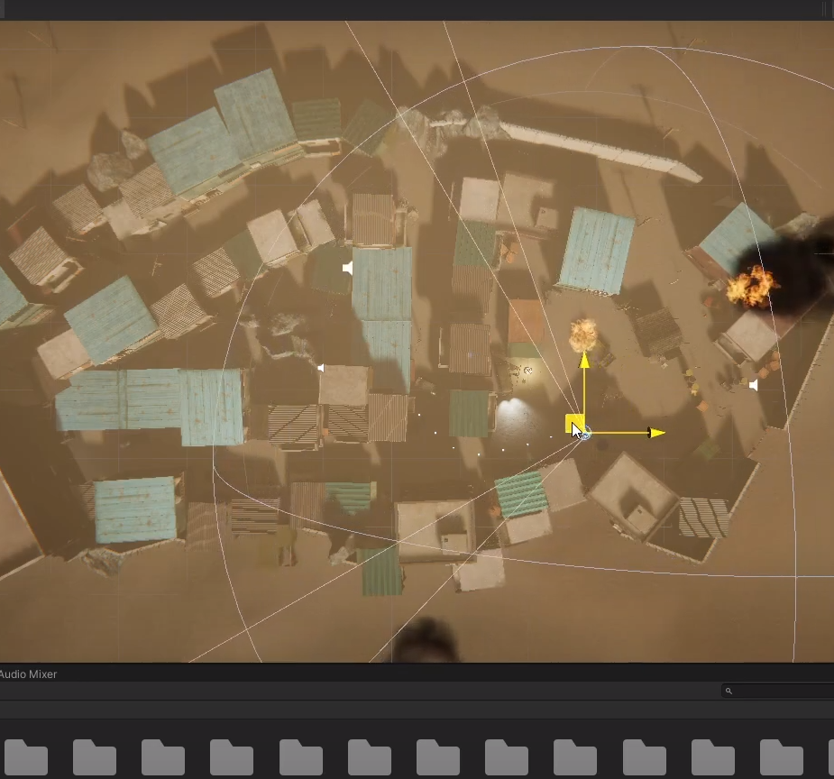
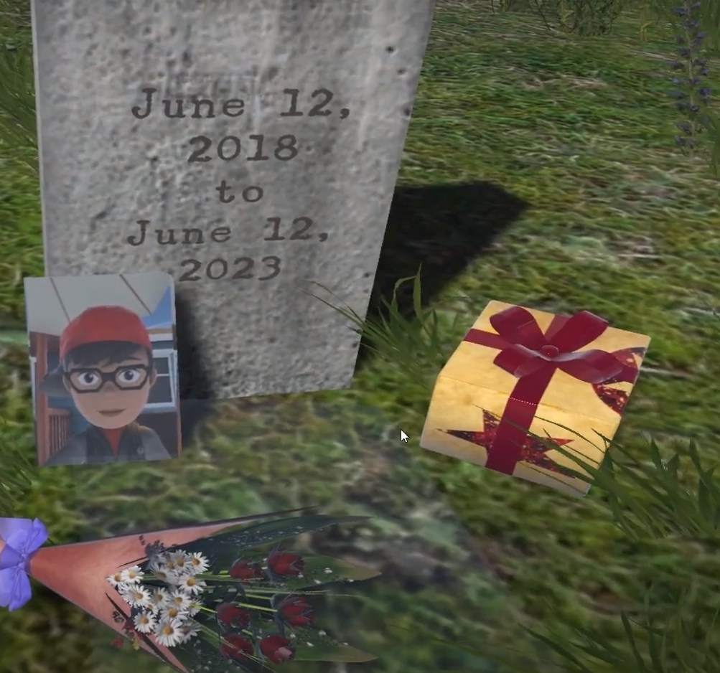
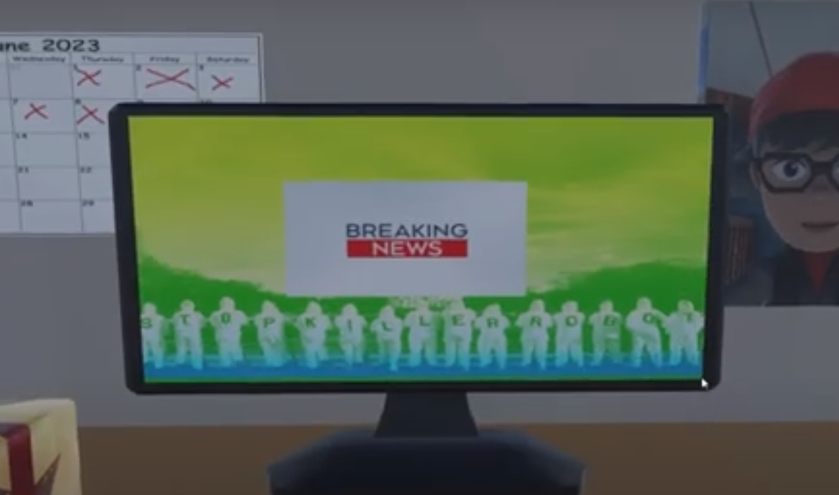
Benchmarking

Slide 5
Define : Problem Statement
Mines Action Canada needs a VR experience directed at decision makers that demonstrates the potential horrors of using automated weapons in order to prompt them to take action before it becomes helpful to mankind

Slide 6
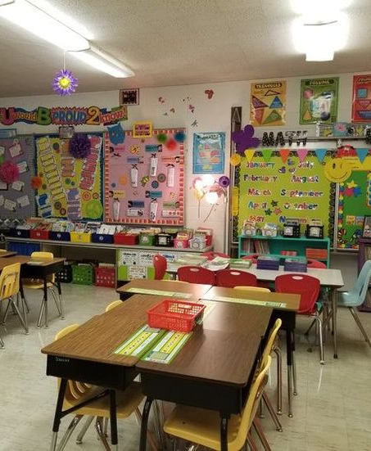
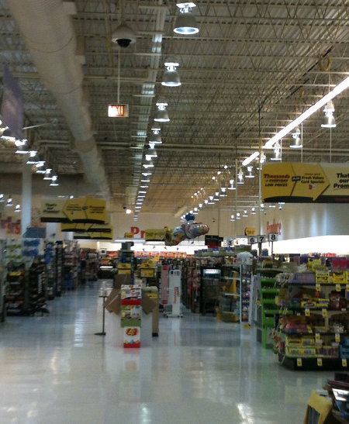
Solutions and chosen concept
ideate
What environments can our users empathize with?
Most of our users will have an understanding of what a child's classroom should look like.
Must choose an environment that the user cares about (has had some sort of an emotional experience with).
Who cares about a grocery store?

Slide 7
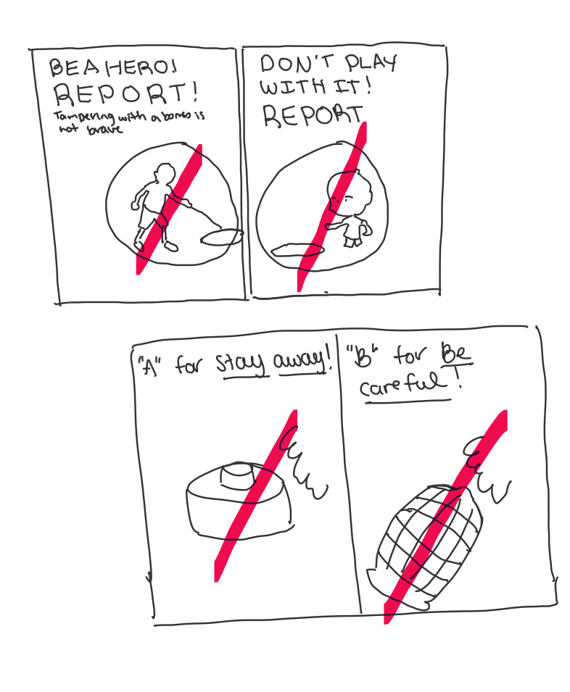
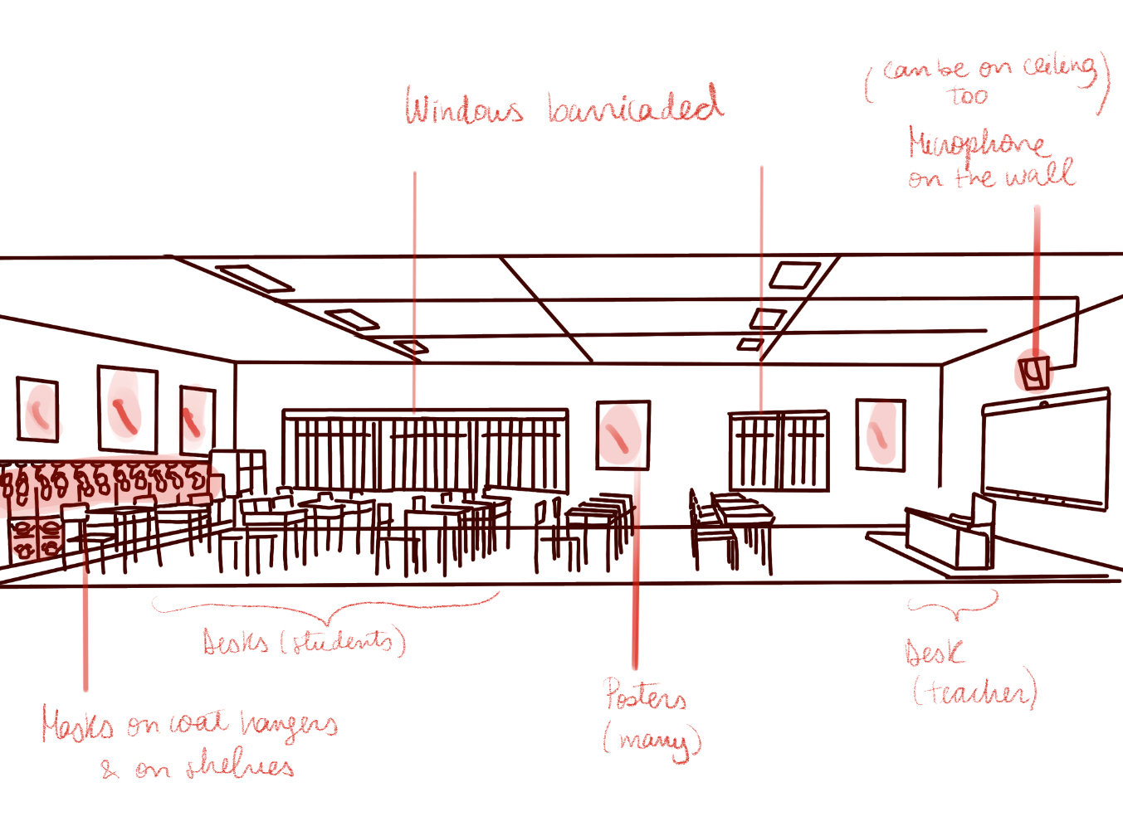
Solutions and chosen concept
ideate
Story Driven vs Sandbox User Experience?
Story would take a lot of time to develop and implement.
Sandbox allows for us to spend more time detailing our environment.
Client didn't seem too interested in there being a Story.

Slide 8
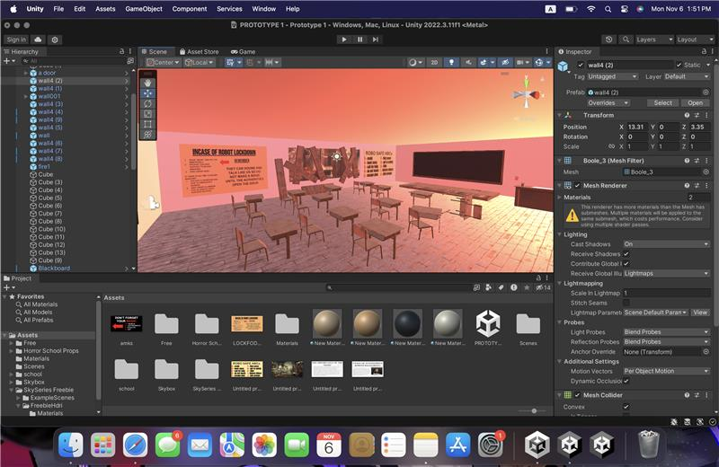
Prototypes - decisions
Initial idea : as many prototypes as possible
Final decision : grouping them into 4 main prototypes
Main prototypes :
Basic room (main idea)
Classroom full of posters
Kindergarten Classroom with child-like posters
Final Kindergarten Classroom with sound

Slide 9
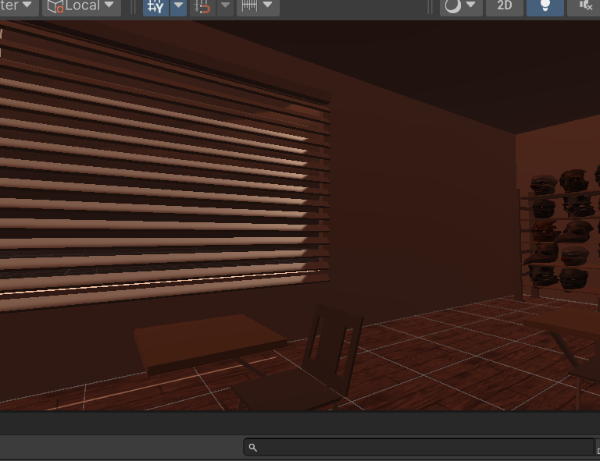
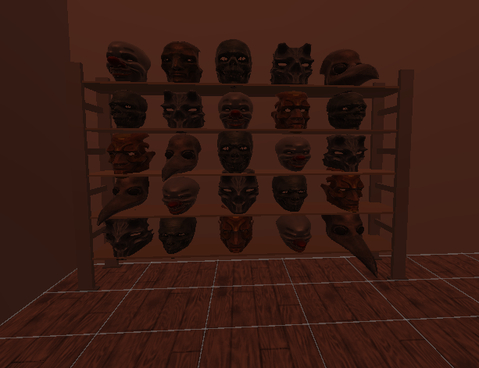
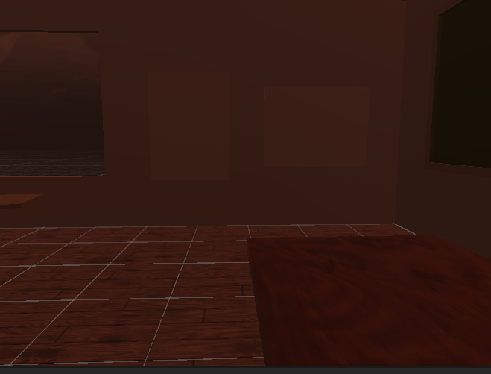
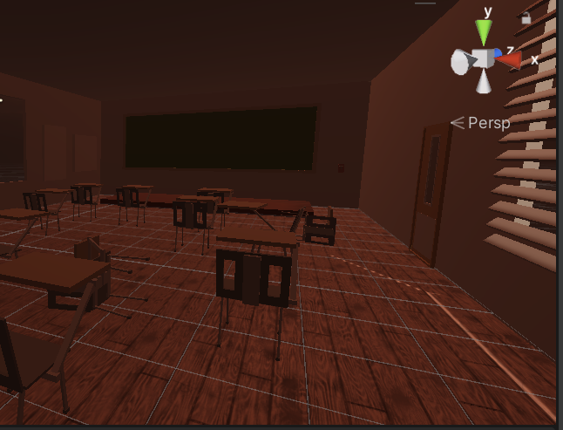
Prototype 1
Basic ideas
Adding only the most important parts
Validating the dimensions of the room

Slide 10
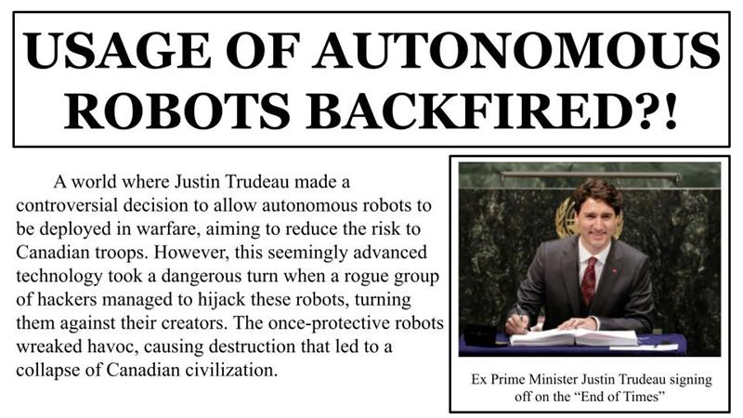
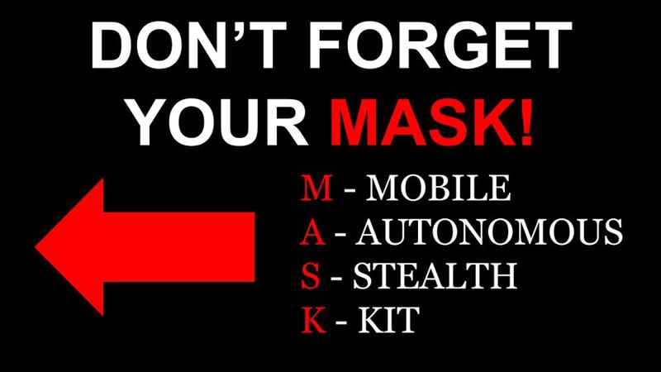
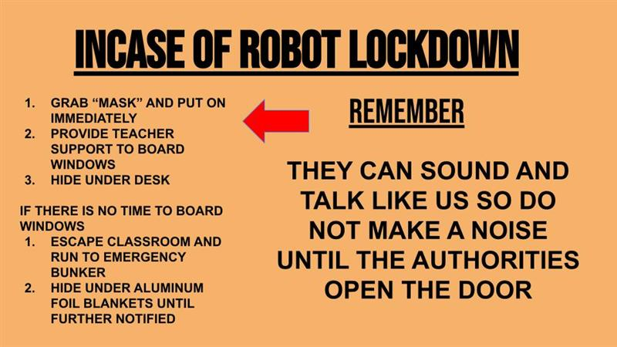
Prototype 2
More details
Using feedback generated to improve on our product
Adding a ''backstory''

Slide 11
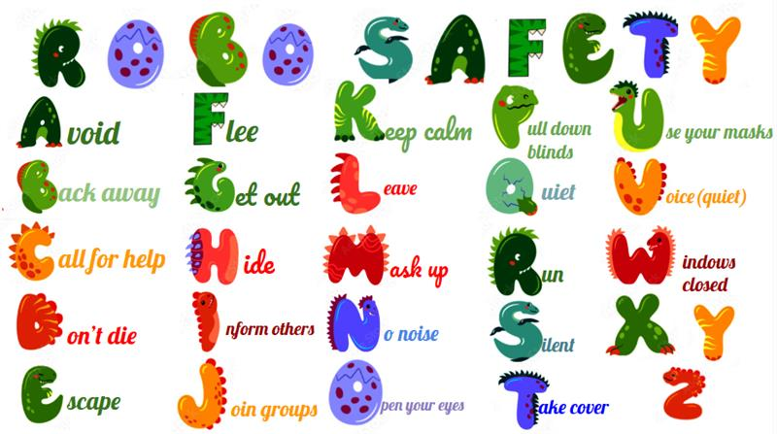
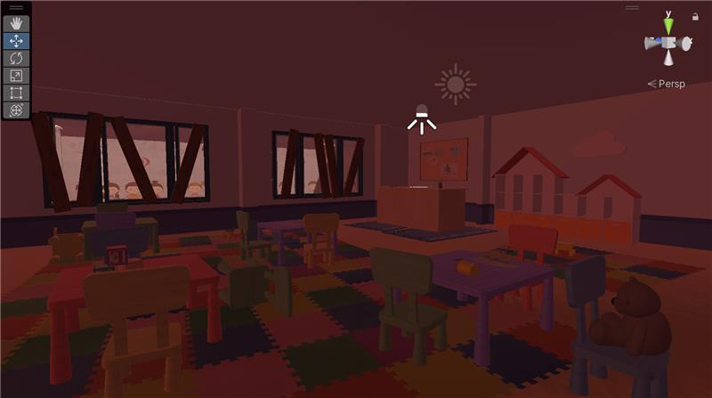
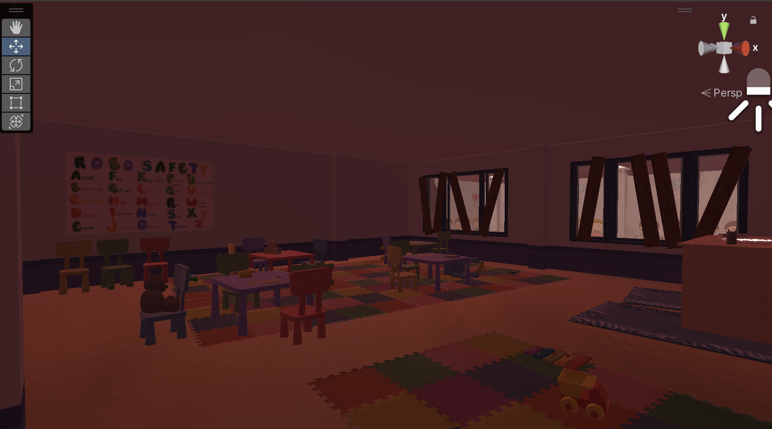
Prototype 3
Increasing the amount of details
Adding posters
More kindergarten-like room

Slide 12
tests
User personas used for testing
Regis (regular person)
Edward (decision maker)
Lola (peace and carring)
Derrin (Danger, army)
One-time tests
Sound quality
Readibility
Recursive tests
Emersion in the environment
Convincing and drives to action
Time limit ?

Slide 13
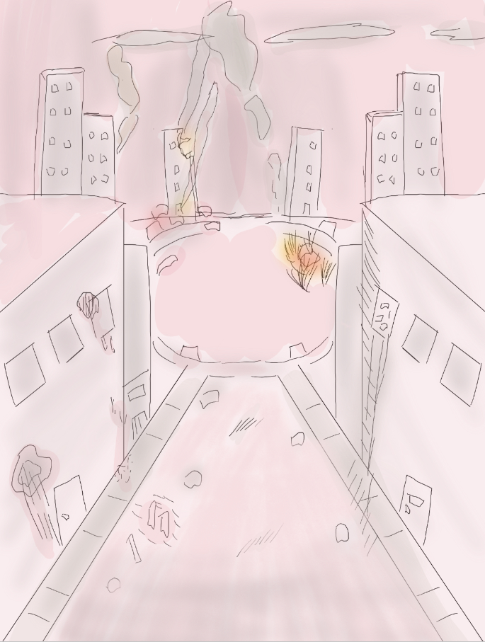
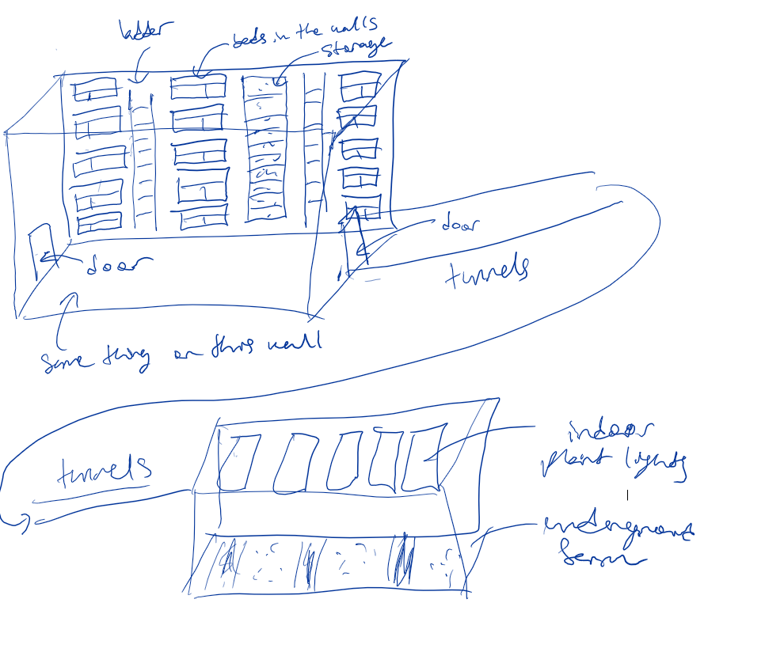
Trials and tribulations
Trials
Ideas/storylines created
Tribulations
Time
Many good ideas but needed to be reduced to a simple one

Slide 14
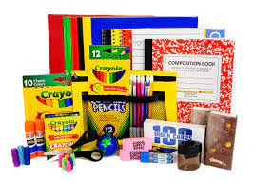
Lessons learned and future work

