Slide 1
DELIVERABLE J MEMBERS DIVINE CIROMA JOHN ZHOU OMOLOLA OMOWA MAGD ABDELMELEK SAAD RANA BRIAN ZHAU
D1- CONSTRUCTION 2

Slide 2
INTORDUCTION
ON THE 22N​D OF JANUARY 2020, WE WERE PRESENTED WITH A TASK TO PROVIDE A PRODUCT FOCUSED ON YOUR NEEDS AND TO IDENTIFY NOT JUST YOUR EXPLICIT NEEDS BUT ALSO THE LATENT NEEDS.
THIS PRESENTATION WILL PROVIDE RELEVANT SUMMARY FROM ALL GROUP DELIVERABLE.
​SIT BACK AND ENJOY!

Slide 3
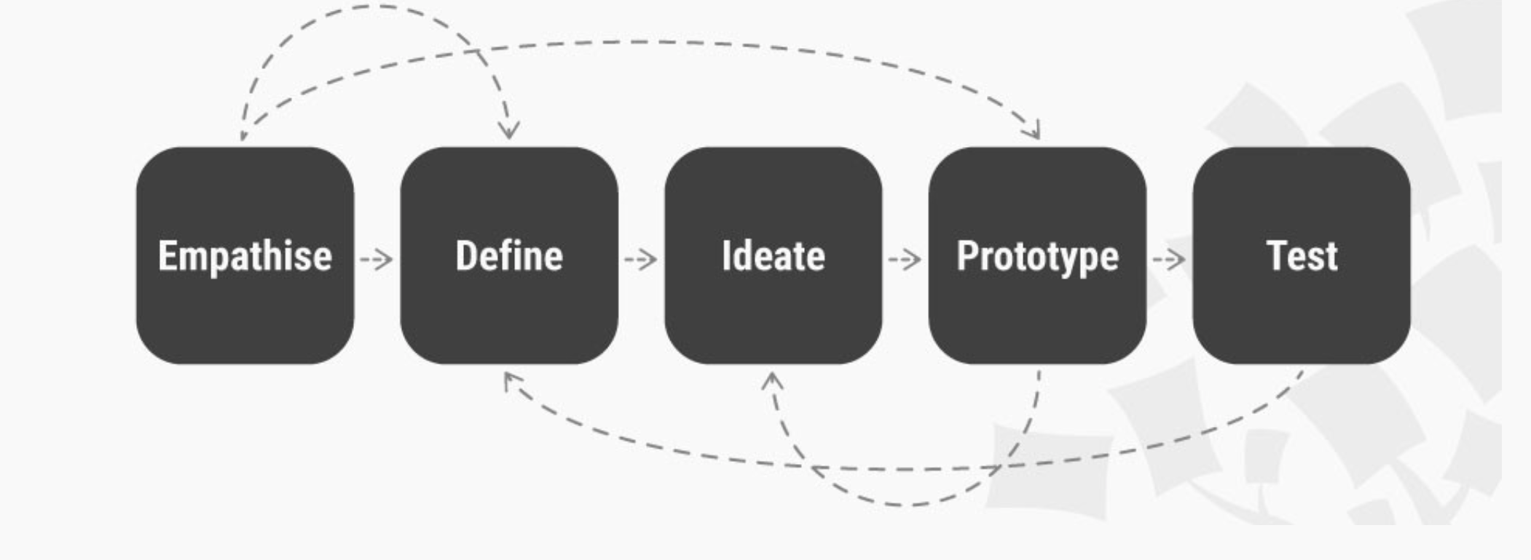
THE FIVE ENGINEERING DESIGN THAT WERE USED

Slide 4
YOUR INTERPRETED NEEDS
THE GREENHOUSE SHOULD BE HIGHLY SUSTAINABLE.
THE GREENHOUSE SHOULD BE COMPACT IN SIZE.
THE GREENHOUSE SHOULD HAVE ITS OWN FILTRATION SYSTEM FOR THE WATER.
THE GREENHOUSE HYDROPONIC SYSTEM SHOULD HAVE ITS OWN HEATING SYSTEM.
THE GREENHOUSE HYDROPONIC SYSTEM SHOULD BE ABLE TO SUPPLY NUTRIENTS TO ITSELF. I.E SELF-SUFFICIENT.
THE GREENHOUSE SHOULD HAVE A BARRIER.
THE GREENHOUSE HYDROPONIC SYSTEM SHOULD BE EASY TO MAINTAIN.
THE GREENHOUSE SHOULD BE EASY TO ASSEMBLE AND DISASSEMBLE EASILY WHEN IT IS BEING TRANSPORTED..

Slide 5
PROBLEM STATEMENT:
The need exists for members of the Algonquin of Barriere Lake community to increase their food supply with the availability of sustainable greenhouse (hydroponic system) that is self-sufficient, easy to control, compact, insulated, affordable, and able to provide warmth all year for growing plants.

Slide 6
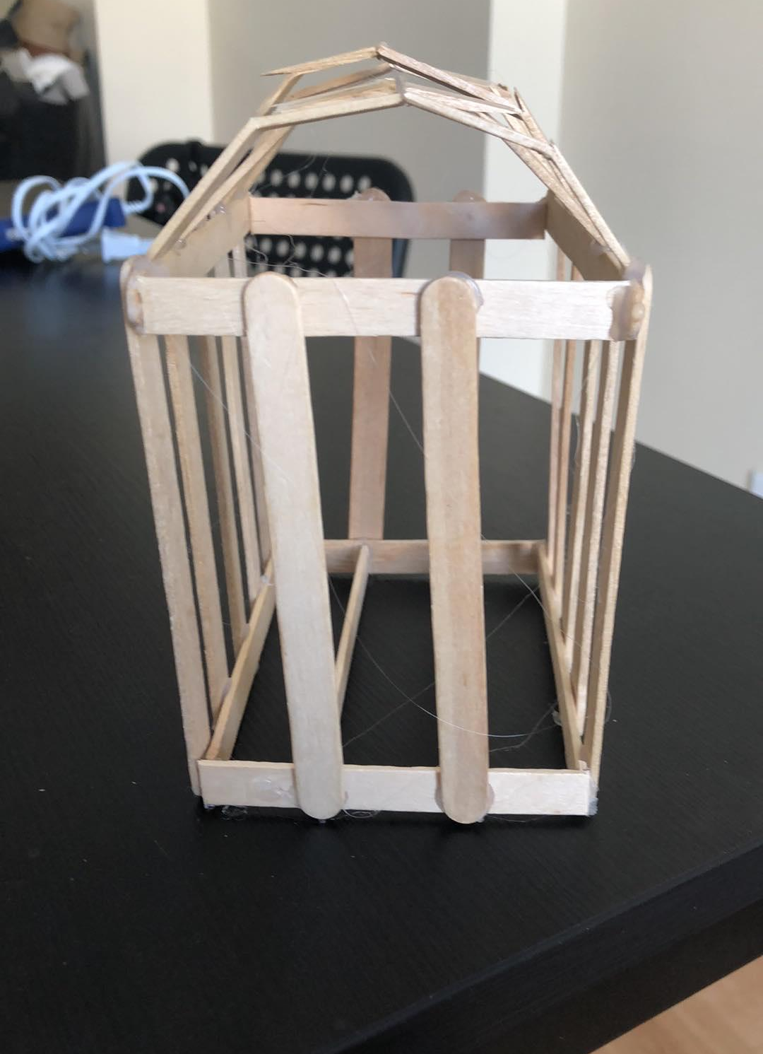
CONCEPT 1
WHY WE CHOSE THIS CONCEPT?
This prototype was chosen because there was available wood scraps from previously used wood. So instead of using fresh wood, we maximized cost by using the wood scraps to construct this concept.

Slide 7
CONCEPT 2
(Our previously decided solution concept)
This design is referred to as a skillion design, due to its single, sloping roof. It was one of our solution option because we were informed by our client that there is usually heavy snow and rainfall in the area, so we thought about this roof because snow and rainfall would be able to fall off easily. Also, it is also easy to assemble and disassemble because of its simple structure.
ccc

Slide 8
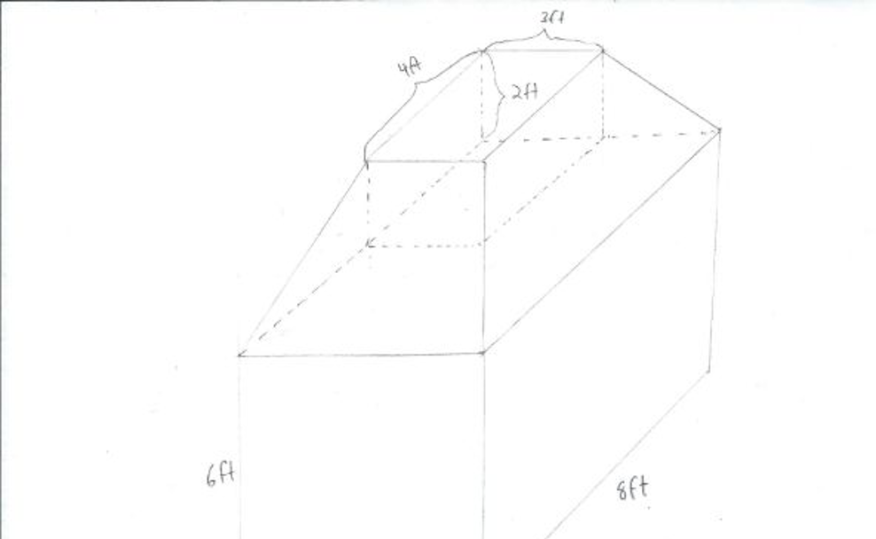
CONCEPT 3
This concept was the most complicated design amongst the three decided concept. This design keeps the pattern of the 6 ft by 8 ft base with a height of 6 ft. However, it includes a 4 way slanted roof with a flat 4ft by 2ft base at the top. This style of roof allows for a great collection of water, and also diversified our options when it comes to the placement of a solar panel. This particular roof style also allows for a large area to store water in the space between roof and the greenhouse. The Large base gives the client ample room to grow vegetation while also being able to have room to move freely in the greenhouse. The frame of the roof will be made of 2 by 4 wood, and will be covered by PVC Panels. The panels allow for a strong, opaque , and relatively cheap roof. The opaque panels will allow for good insulation while also allowing sunlight to penetrate the roof. This design was not chosen because of the excessive weight which the tank provided on the building itself. There were so many ideas that were needed to make this design success and due to time constraints, we were not able to think the concept through.

Slide 9
Specification | Concept 1 | Concept 2 | Concept 3
Product life Span | Five years | Five years | Five years
Rodent/insects Resistance | yes | yes | yes
Dimension | (9 x 6) ft | (8 x 6) ft | (6 x 8 x 6) ft
Easy to assemble and disassemble | yes | yes | no
Weather resistant | yes | yes | yes
Price | Cheap | affordable | expensive
Water Collection | great | great | excellent
Snow load Resistance and Capacity | yes | yes | yes
Ventilation Included | yes | yes | no
Space available | yes | Instructions would be given, but can be tricky | Instructions are given, but would definitely be tricky
Frame material | Wood planks, plexiglass or plywood | Wood planks | Wood planks and polyethylene film
Time and energy consuming | no | Takes more time to build than concept 1 but takes less time to complete than concept 3 | yes
Tools needed for maintenance | Screw and nails | Nails, Bolts, Nuts | Screw, Bolts, Nuts
Doors Included | yes | yes | yes
Weight | 119lbs | 114lbs | 260lbs
Total Score | 40 | 35 | 25
BENCHMARKING 1
EVALUATION FOR EACH SPECIFICATION ON A SCALE OF 1-3: 3-GREEN, 2-YELLOW, 1-RED (3 BEING THE HIGHEST)

Slide 10
COST ANALYSIS
Item # 1 | Material | Element of Structure | Quantity | Dimensions (ft.) | Unit Cost/$ | Total Cost/$
1 | Wood | Base | 6 | 2x4x8 | 3.25 | 19.5
2 | Plywood | Flooring | 2 | (11/32 inches) x4x8 | 15.53 | 31.96
3 | Wood | Front and Back Frame (Walls) | 12 | 2x4x8 | 3.25 | 39
4 | Wood | Side Frame (Walls) | 14 | 2x4x8 | 3.25 | 45.5
5 | Metal | Door lock | 1 | 6 (inches) | 25.51 | 25.51
6 | PVC (plastic) | Roof Panels | 5 | 2x8 | 25 | 115
7 | Wood | Roof Frame | 6 | 2x4x8 | 3.25 | 19.5
8 | Vinyl Sheet | Wall coverings | 8 rolls | 4.5x45 (16 mil thickness) | 3 | 24
9 | Plastic | Gutters | 1 | 8 ft long | 3 | 3
10 | metal | Nails, screws and rafter hangers | N/A | N/A | 20 | 20
11 | Paints | Base Structure and Bottom wall | 2 | N/A | 3 | 3
12 | Wood | Support | N/A | N/A | LEFT OVERS
13 | Plywood | Door (exterior) and bottom wall | 1 | (11/32 inches) x4x8 | 15.53 | 15.53
14 | Copper Mesh | Base | 1 | 45 X 12 inches | 37.93
Total Cost Estimate |  |  |  |  | $ 399.43 + tax

Slide 11
PREVIOUS PROJECT SCHEDULE

Slide 12
PRESENT PROJECT SCHEDULE

Slide 13
CONSTRUCTION (DESIGN PROCESS)

Slide 14
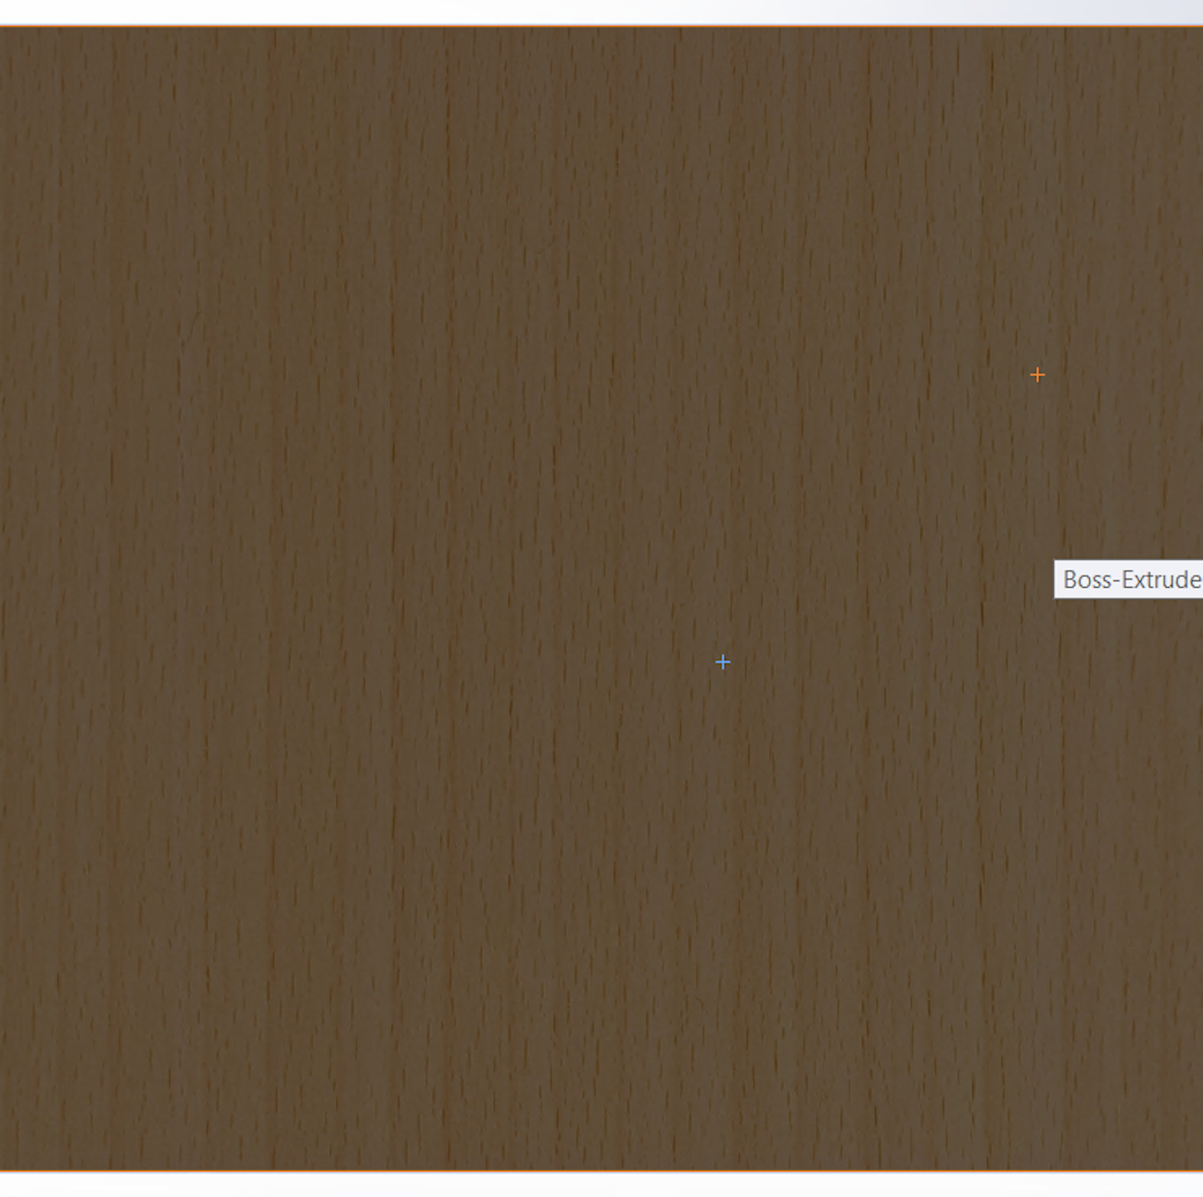
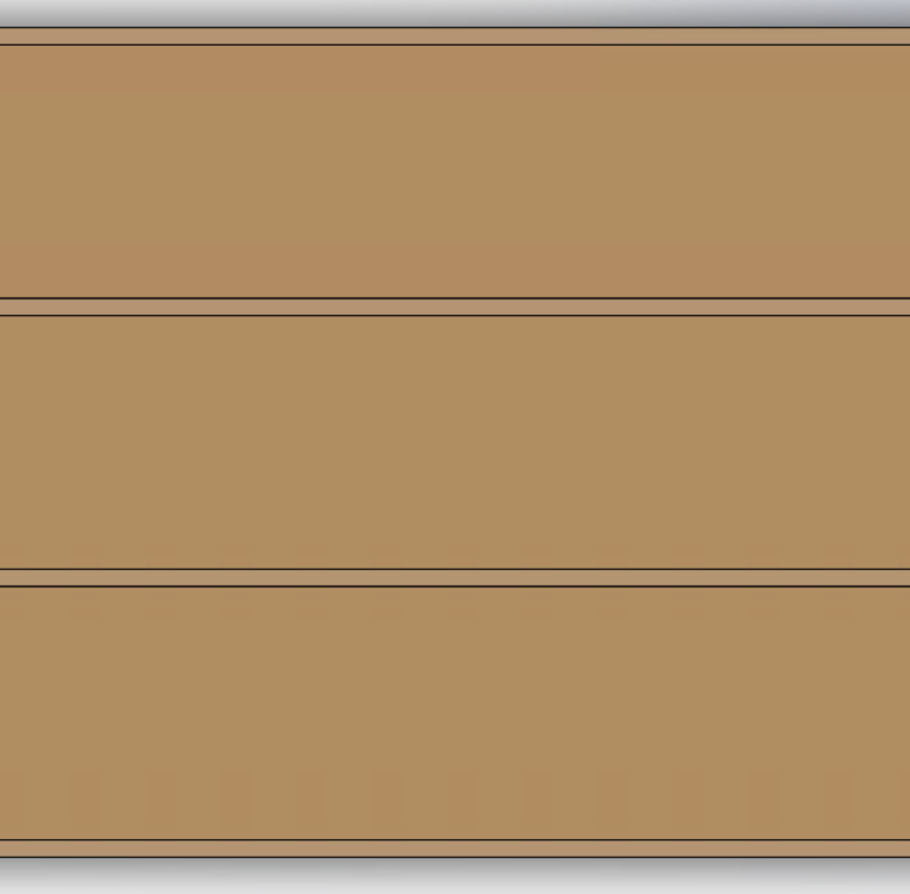
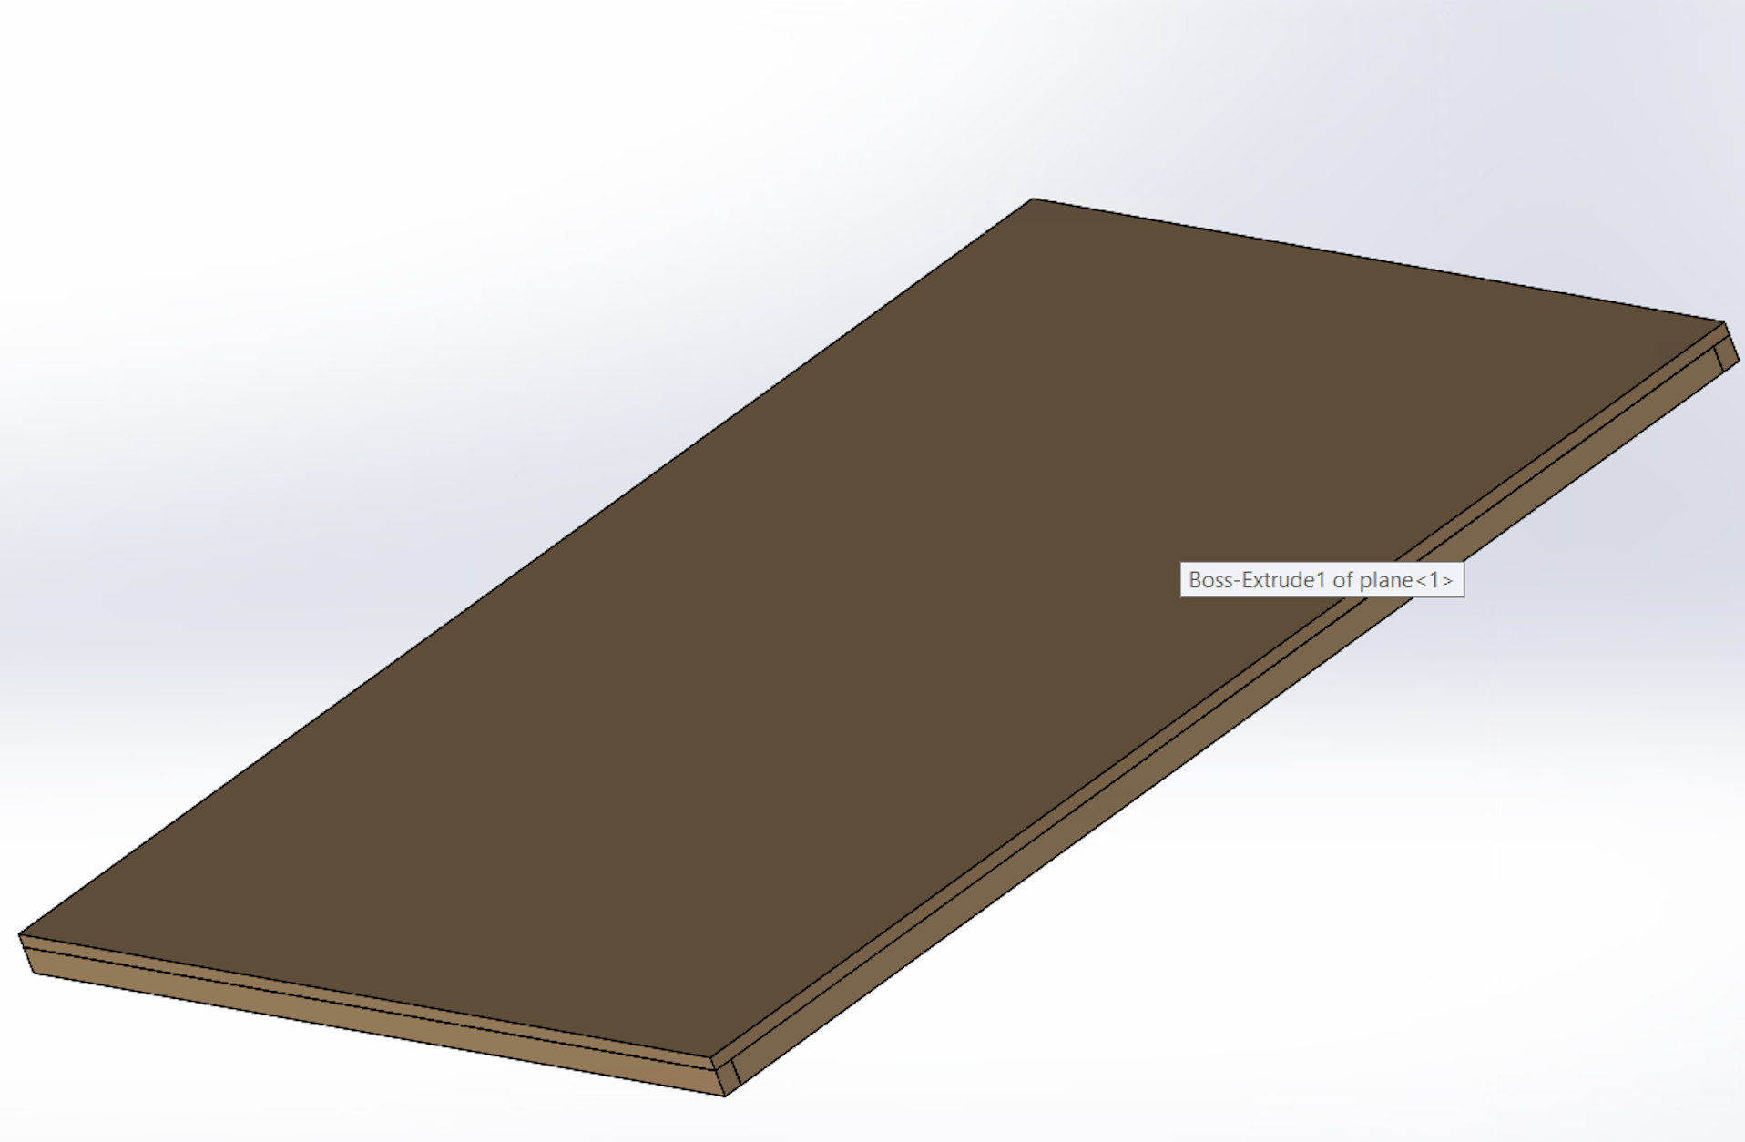
BASE (FOUNDATION)
Week 1
The strength of a greenhouse lies in its foundation.
The main purpose of the foundation is to hold the structure above and keep it upright.
Material used: lumber wood and plywood (OSB).
Dimension: - Height 3 inches
- length: 8 ft
- width: 6 ft
Note: We used SOLIDWORKS to help stimulate a physical behaviour of our Design.
Bottom view
Top view
Side and front view

Slide 15
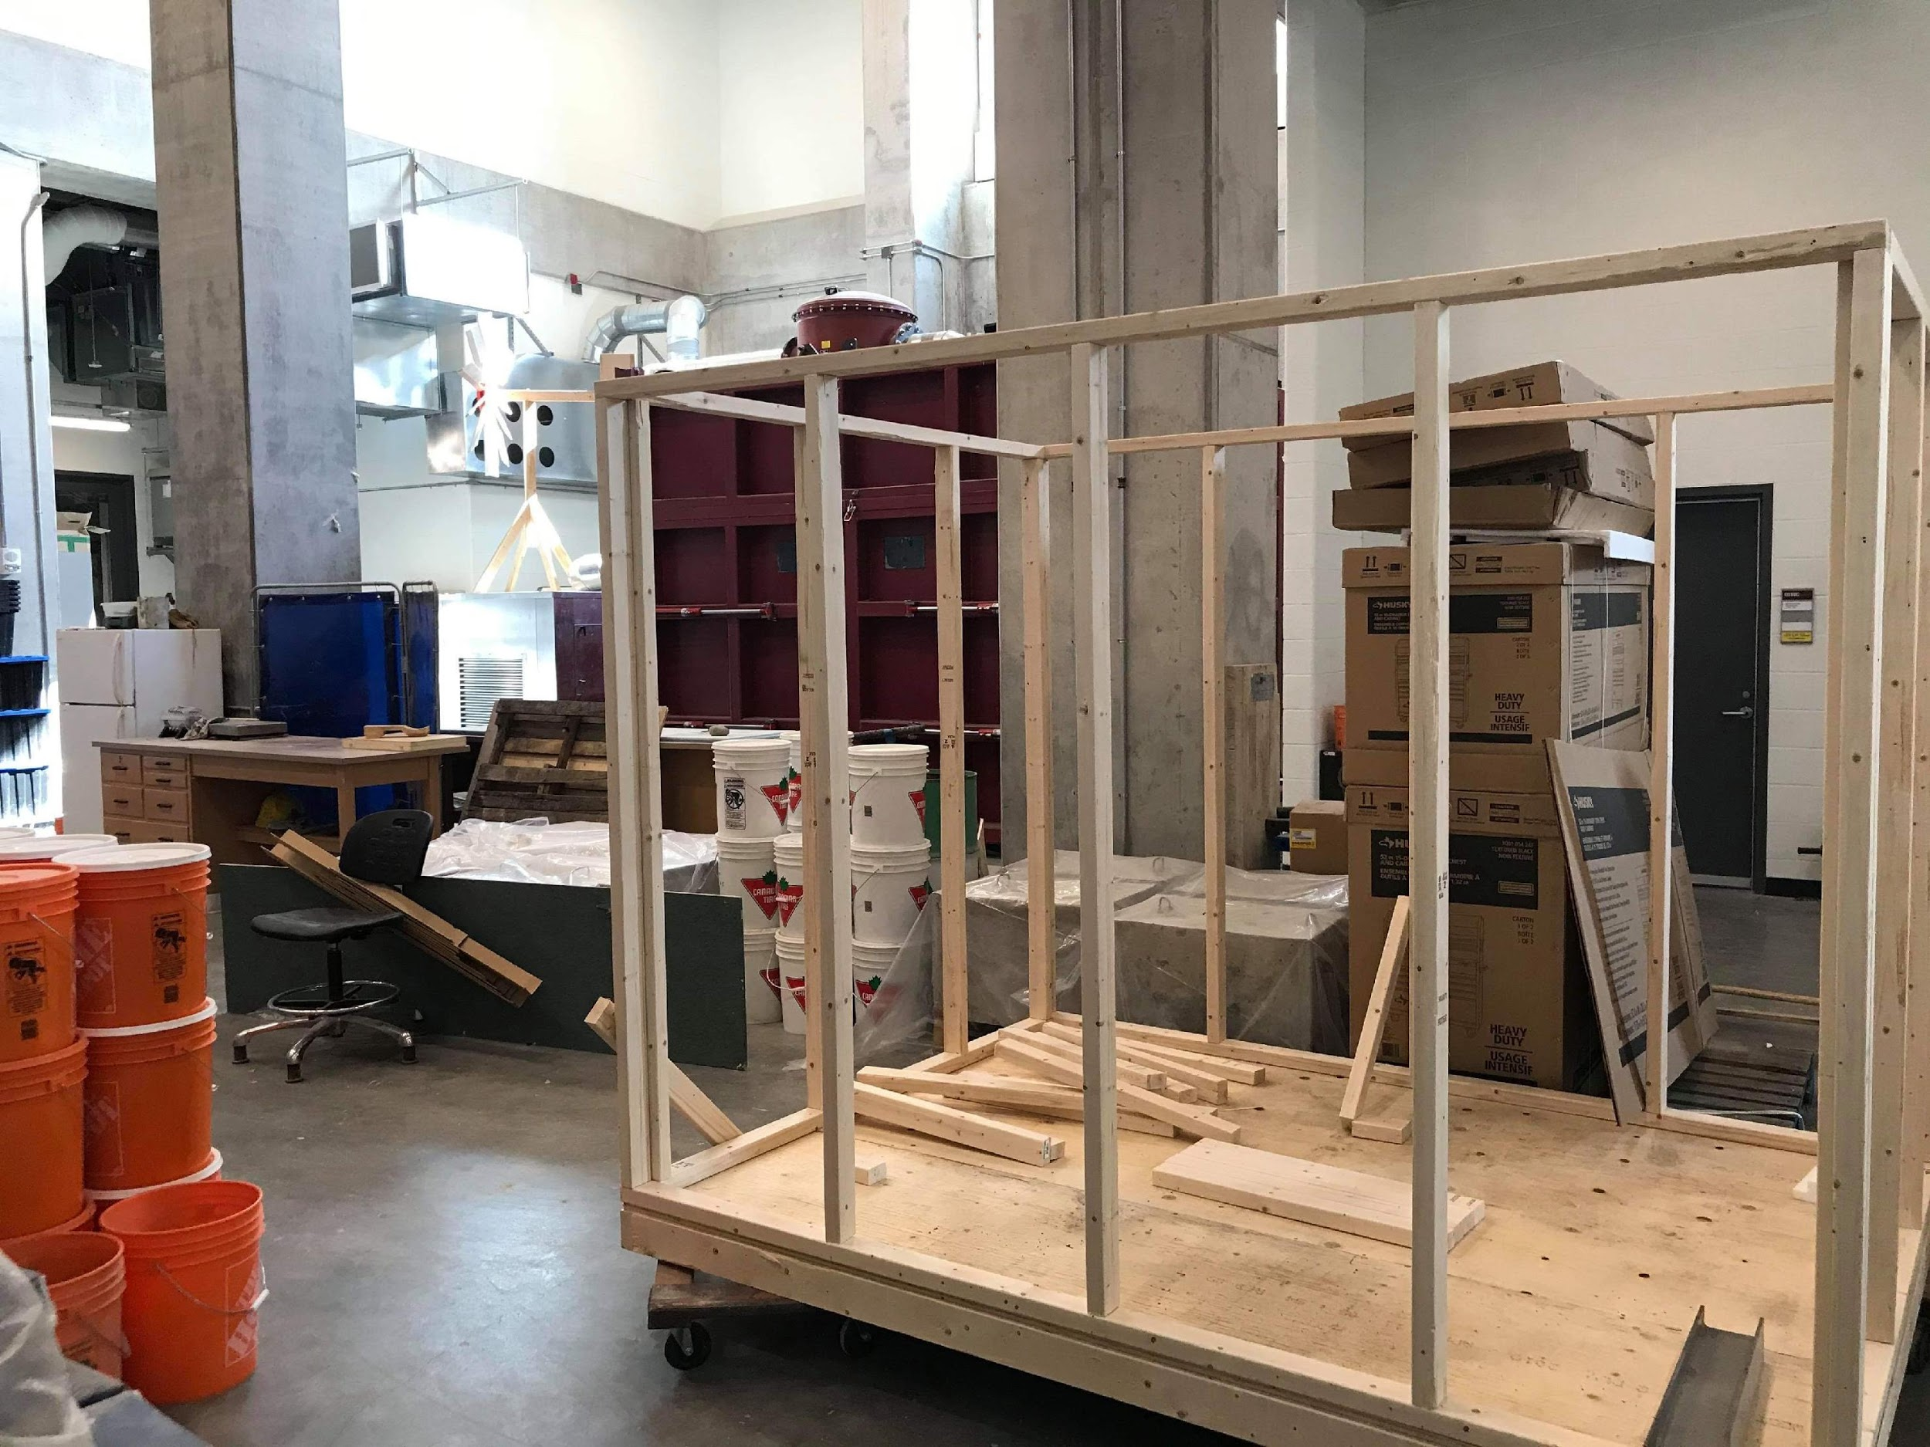
WALLS (FRAME)
Week 2
Material used: lumber wood
Dimension: - Height 6ft.
- length: 8ft.
- width: 6ft.
We used nails to connect the lumber woods.
We used screws to join the front and side view because it would be easy to disassemble the frames and transport it to another location.

Slide 16
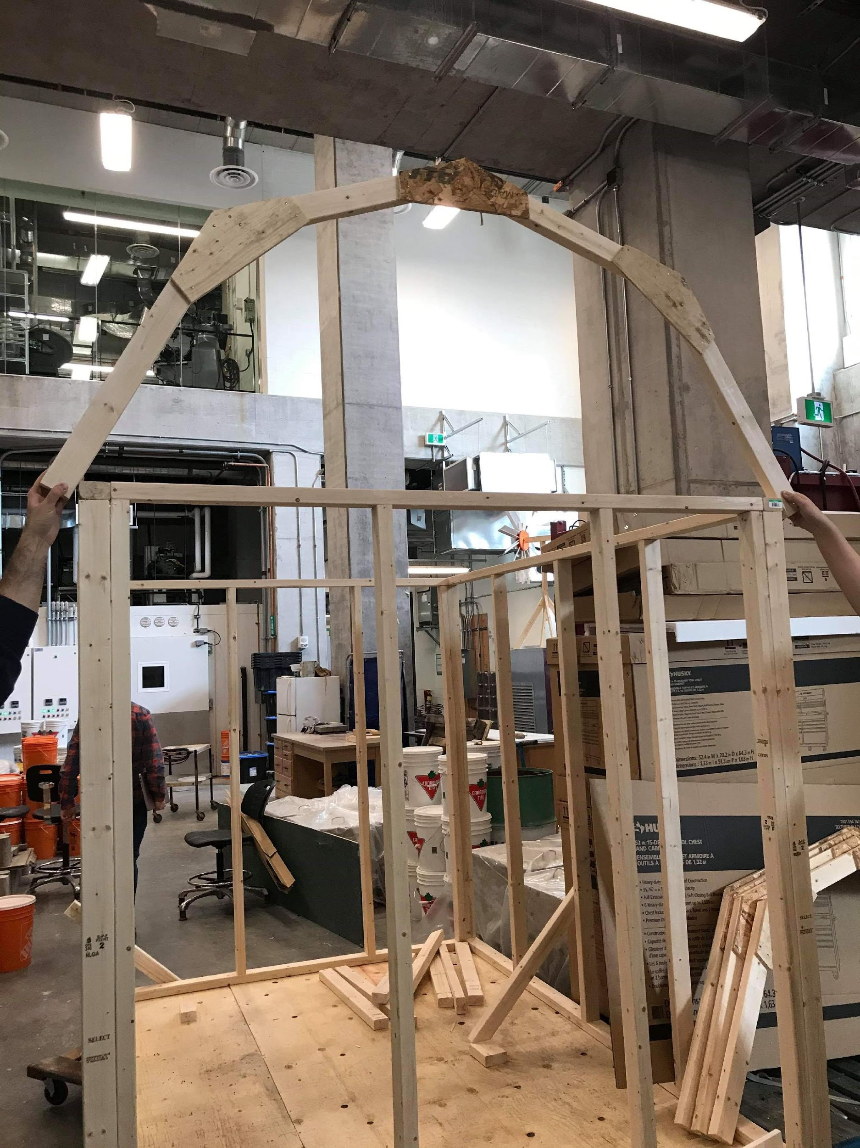
RRoij
Week 3
Roof (Frame)
A Gambrel roof design has a symmetrical two-sided structure with 2 gradients on each side.
The lower slope is very steep, usually around 60 degrees while the upper slope has a much shallower angle, approximately 30 degrees.
Material used: lumber wood and plywood (OSB).
Dimension: - Height 2.8 ft.
- length: 8 ft
- width: 6 ft
We used plywood and nails to connect the lumber wood together.
Advantages:
- Maximises space
- Less materials Needed (less cost)
- Good Drainage (The steep sloping sides of a Gambrel roof design allows the rain and snow to simply run off the sides without getting caught).

Slide 17
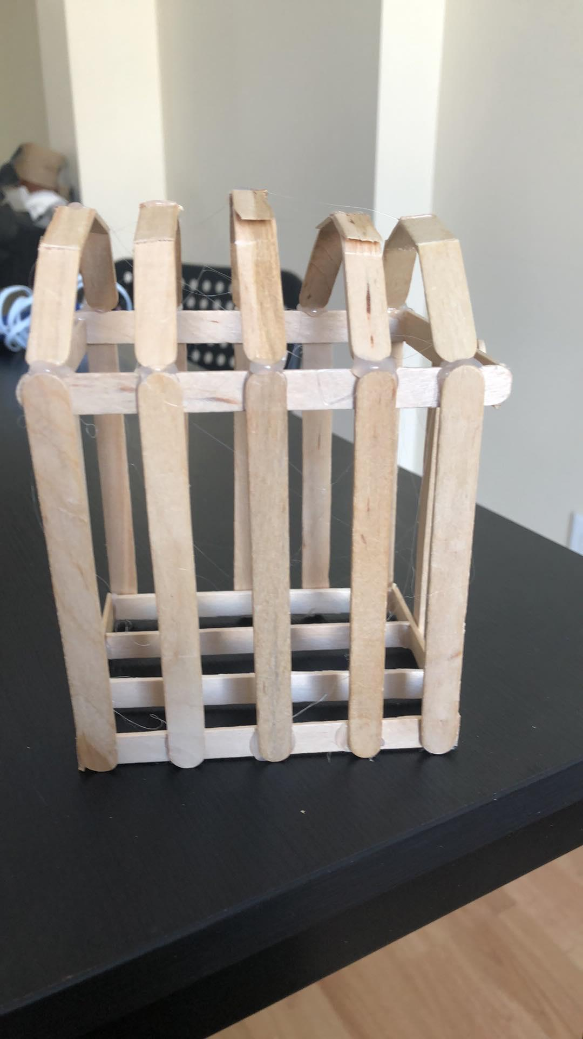
PROTOTYPE 1
Week 4
Prototype 1 design represent a smaller scale of our actual design.
We used inexpensive materials like small popsicle sticks bought from the Dollarama store and put together using adhesive, which both cost 15$.
Prototype 1 is the most essential part of any designing project because it helps us figure out what did not work, and what was required by the client to make the project a favourable outcome.
Side view

Slide 18
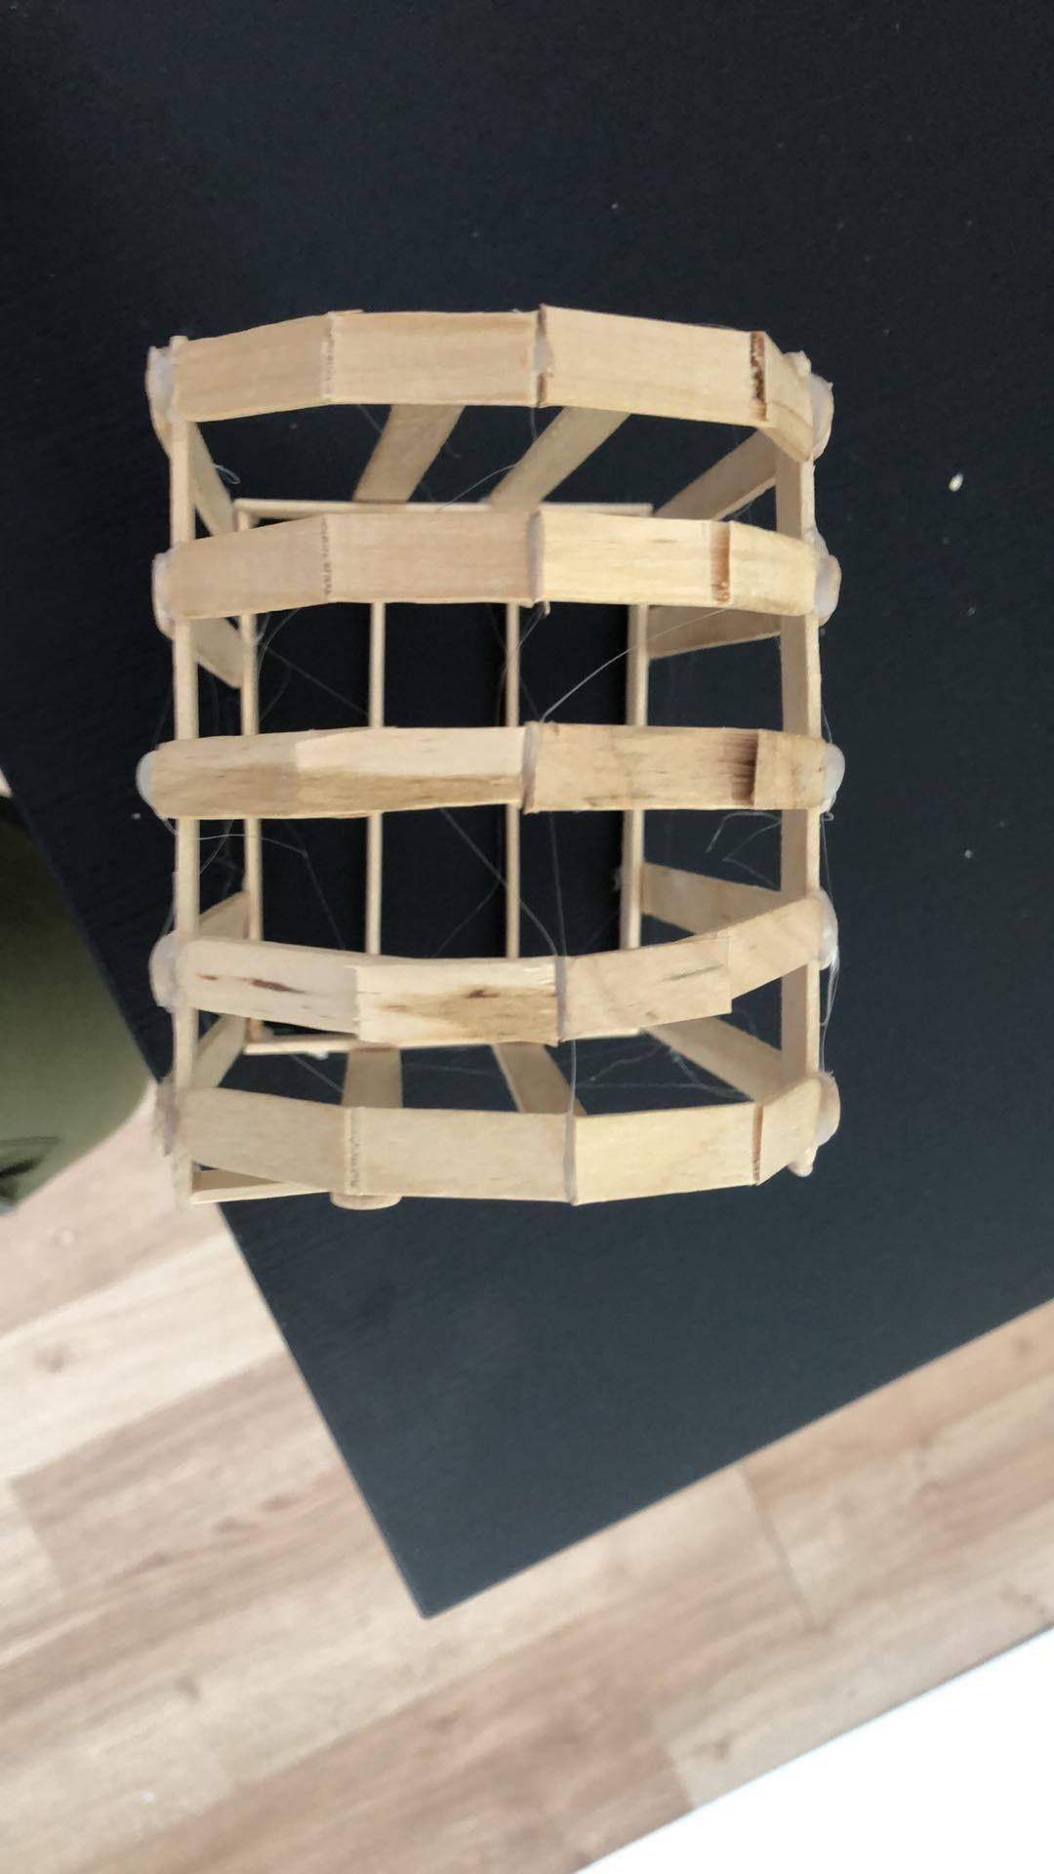
PROTOTYPE 1 (TRIALS AND TRIBULATION)
Week 4
In the winter, the roof must be able to handle heavy snow.
One of the most critical features we wanted to test was how stable the gambrel roof design and the walls were to hold the weight of the snow
Trial: using our hands, we applied a lot of force on the roof and walls in order to test the stability of the greenhouse.
Our observation: without any support on the roof and wall the greenhouse was shaking.
Top view

Slide 19
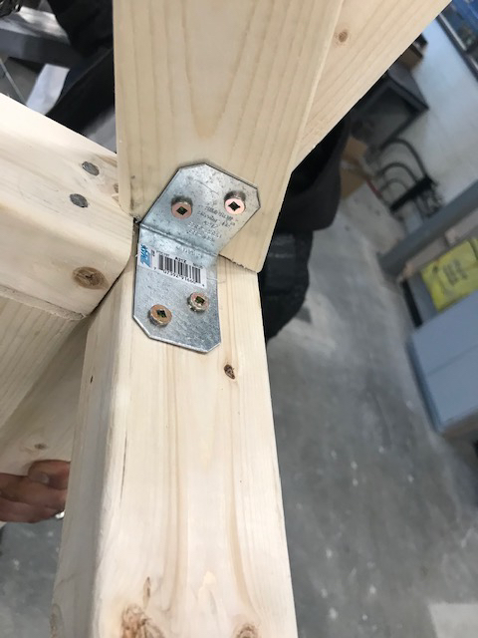
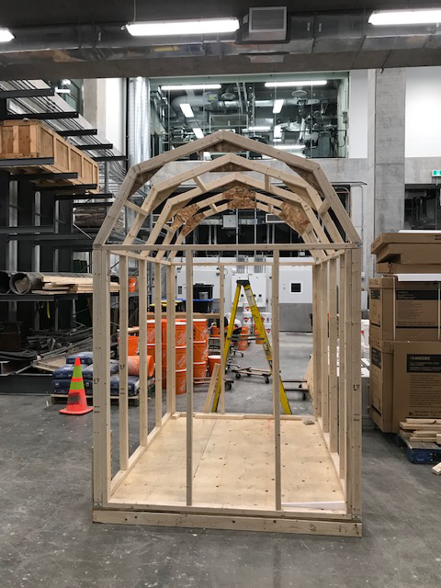
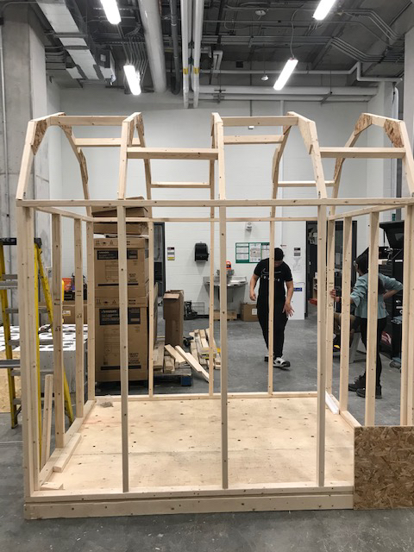
WEEK 5
Roof frame
(continuation)
We connected all the roof frame using screws and rafter hangers in each side for the greenhouse to be easy to assemble and disassemble when it is being transported.
To improve Prototype 1, we added more wood to each wood frame to improve the stability of the greenhouse.

Slide 20
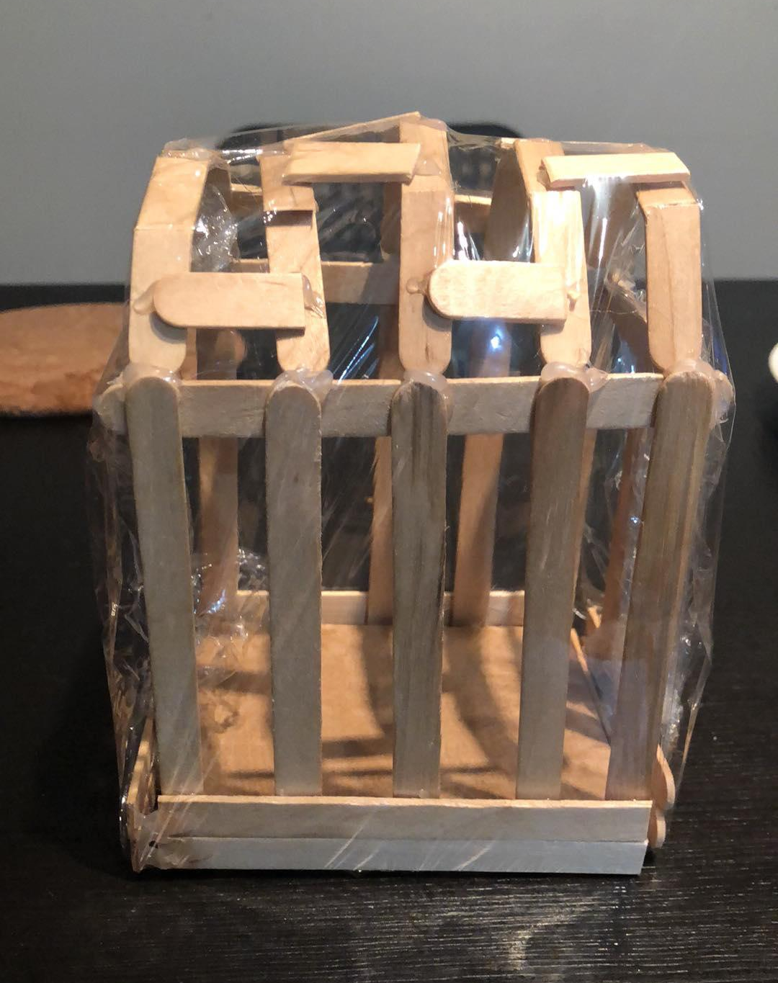
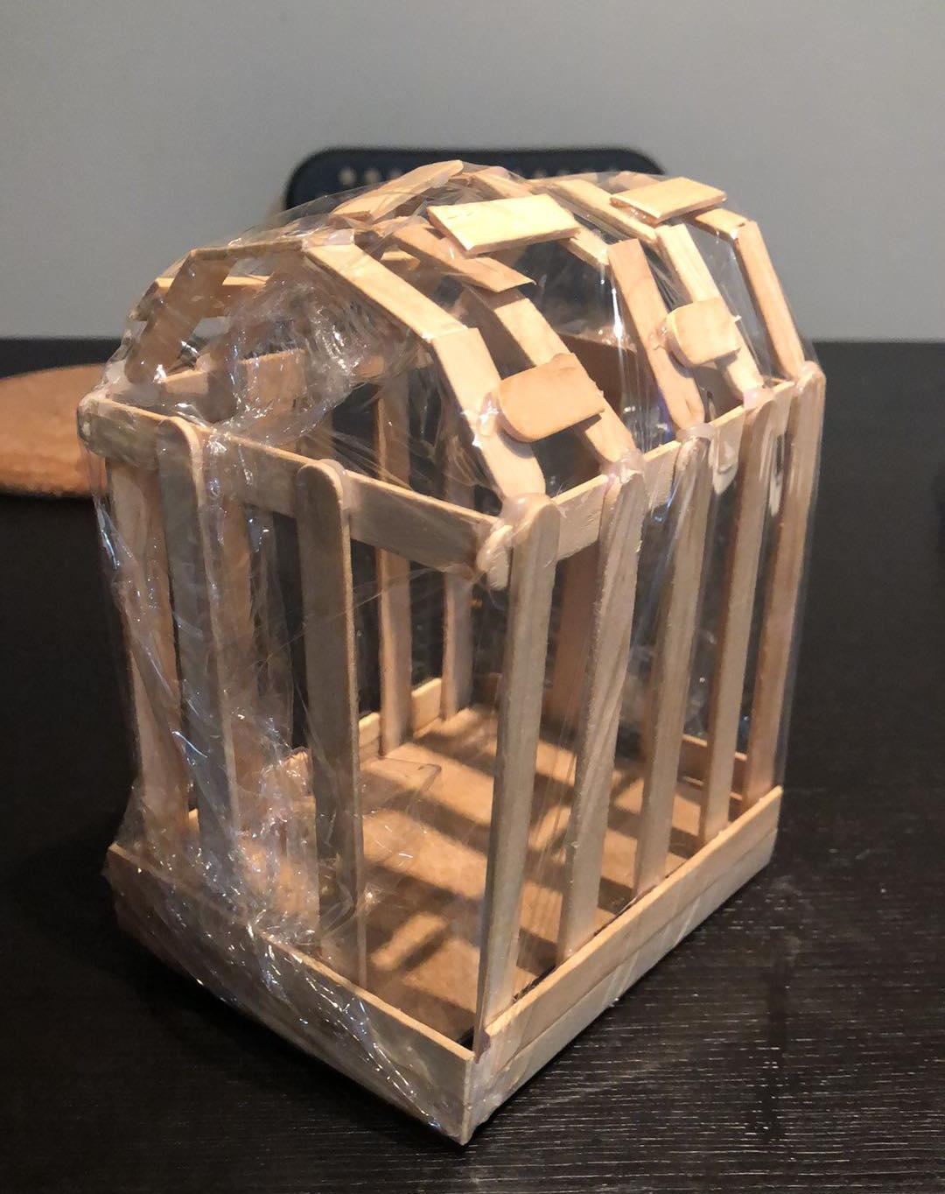
PROTOTYPE 2 (TRIALS AND TRIBULATION)
Week 6
Prototype II fills in as an enhanced disposable model made to comprehend the fundamentals of the design before the plan continues further.
Prototype I was modified to create the second prototype, that accurately displays the pieces of the greenhouse. While constructing prototype 1, we realized that there should be more structural support in the walls and roof.
In order to fully visualize the second prototype, we used more popsicle sticks at the roof and cardboard at the bottom of the wall that had already been glued together to show the support that needed to stabilize our structure. Moreover, we used a small transparent plastic bag to show that the material we chose to use for our roof and walls will be translucent, which allows sunlight to easily enter our greenhouse.
Trial: we poured a lot of water on the roof in order to test whether or not the water wall fall smoothly to the ground.
Our observation: It was a success!

Slide 21
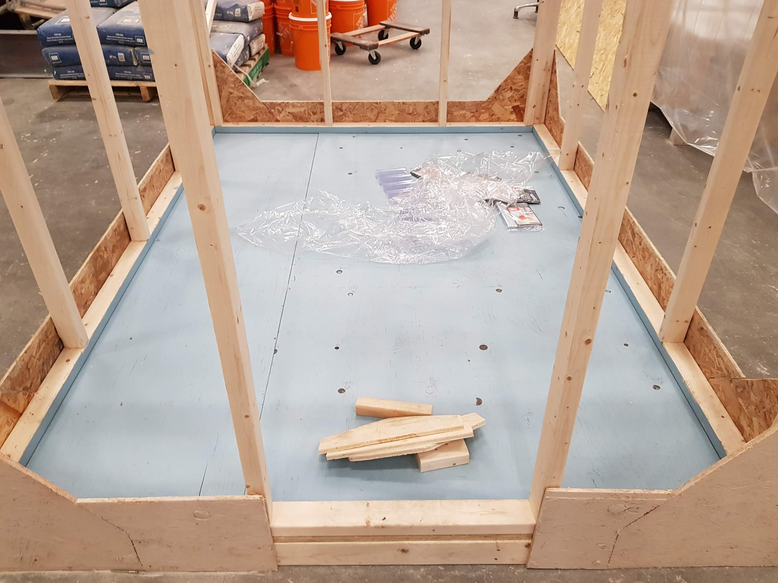
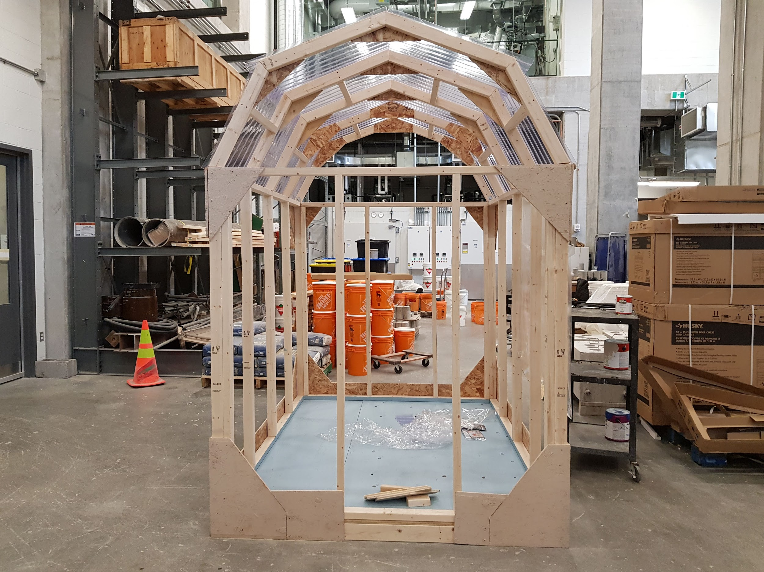
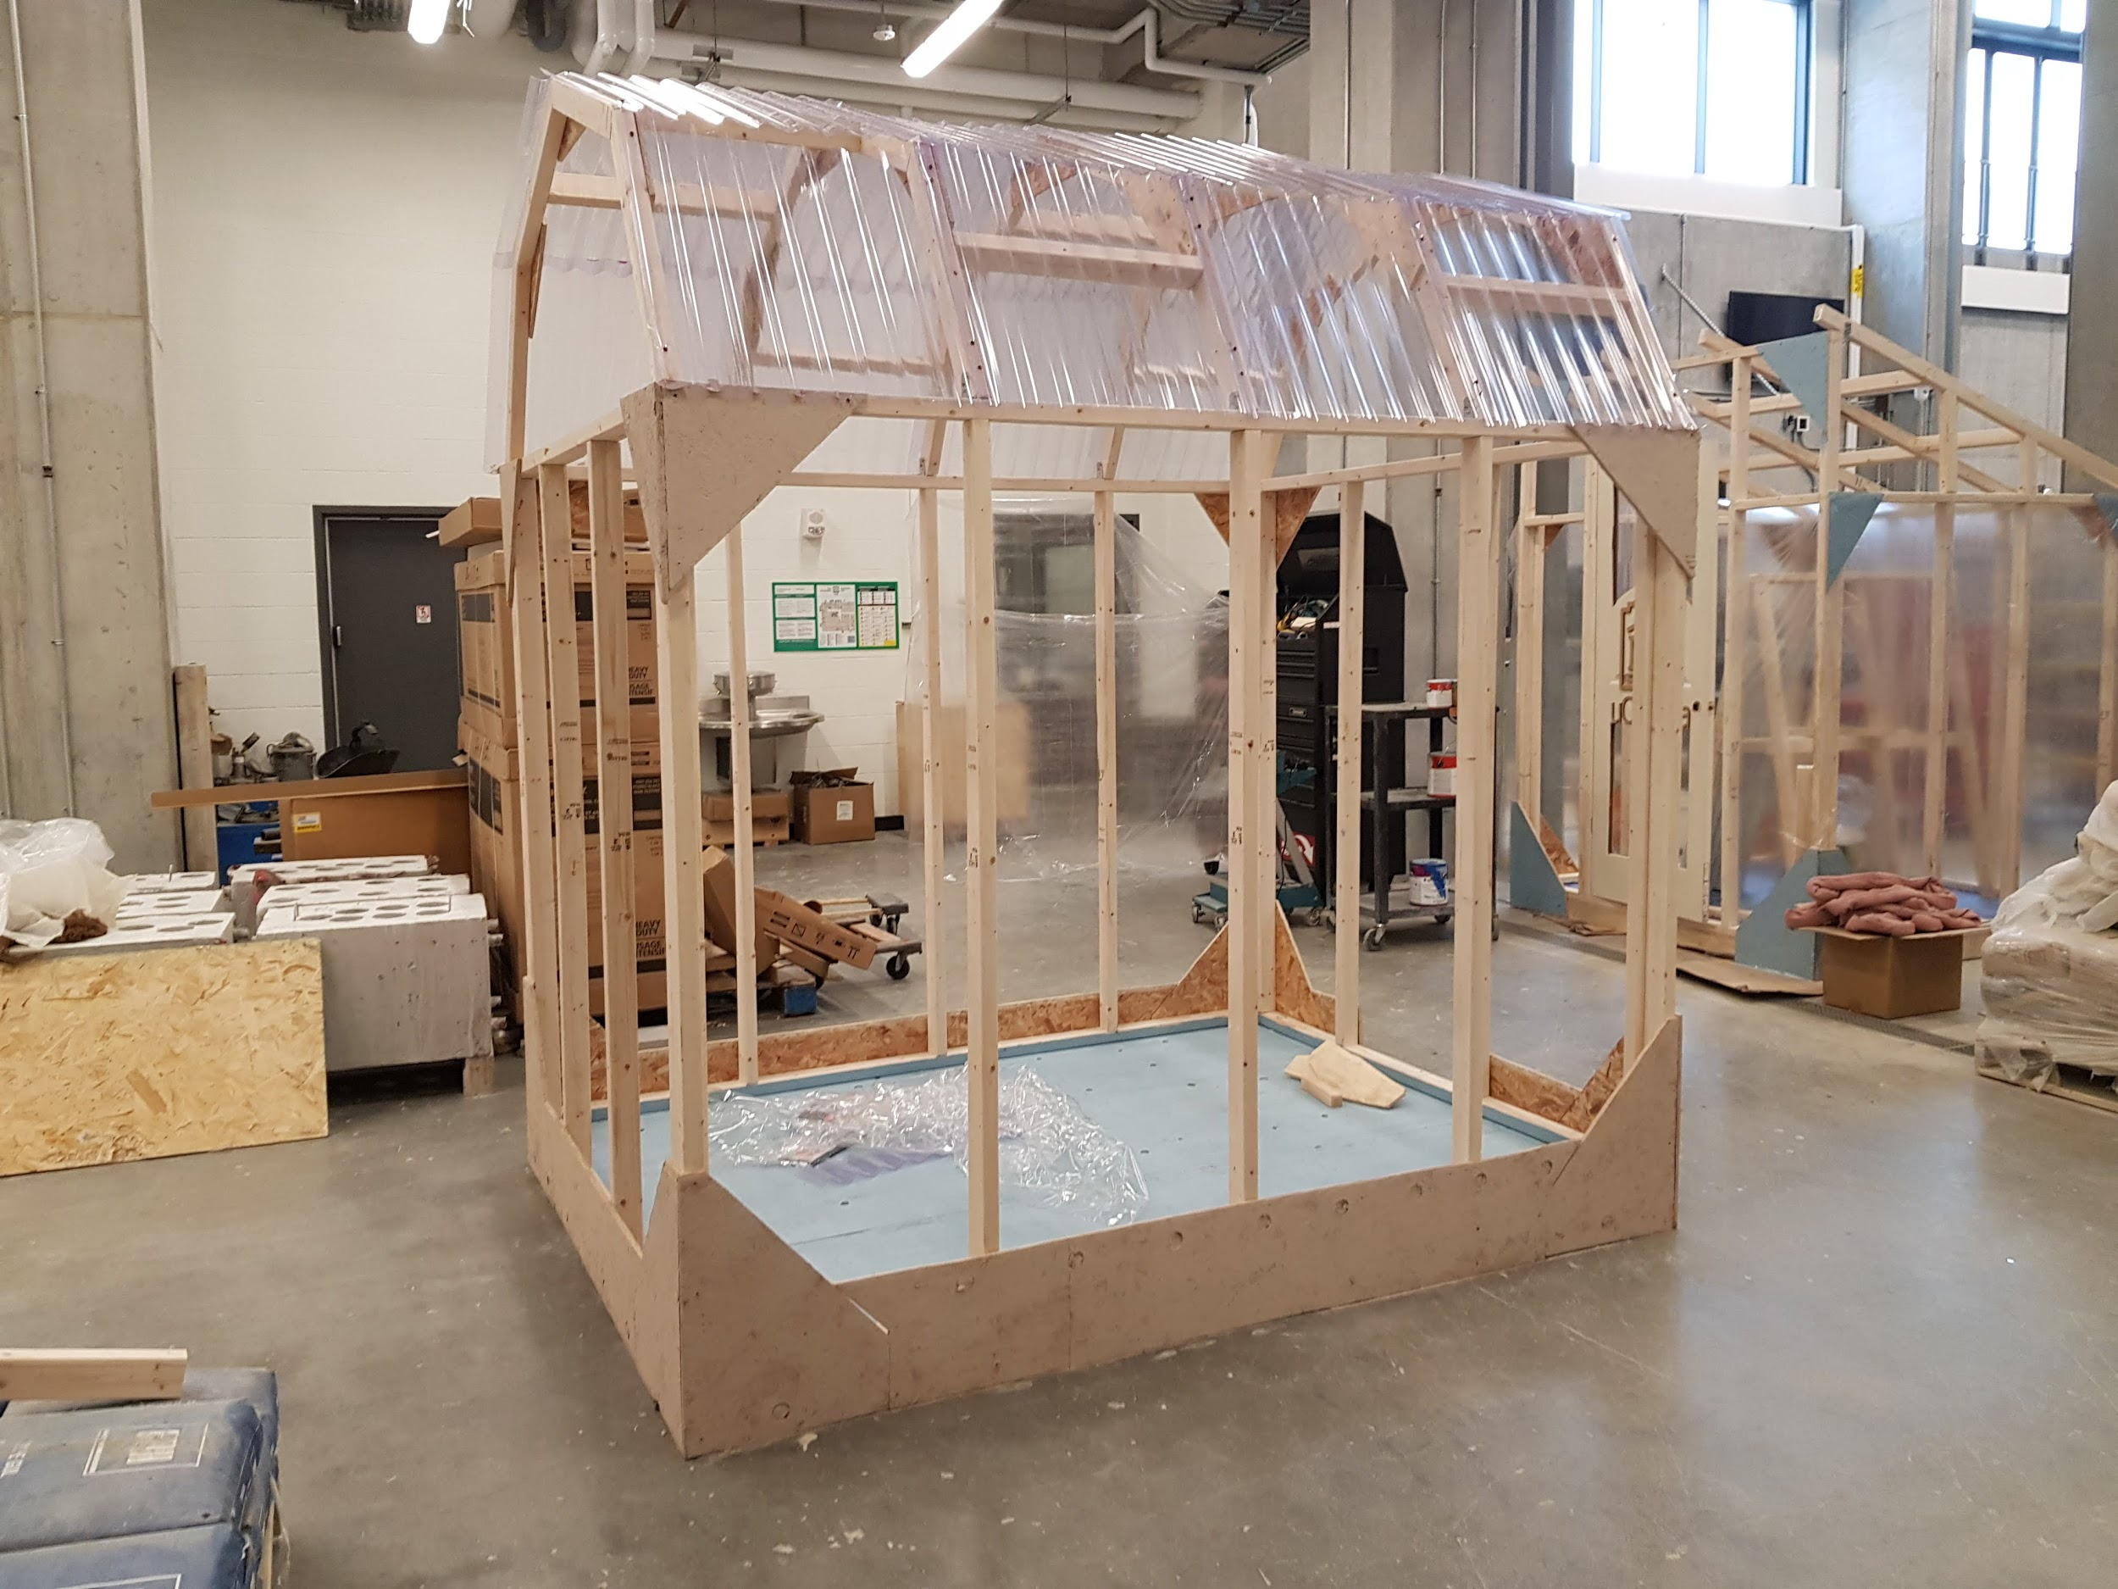
Roof Covering, Painting, and plywood (on the bottom and top)
Week 8
We used PVC roof paneling to easily collect the water, and allow the sunlight to enter through the greenhouse.
Plywood was used all around the base for more stability and protection.
Also, we were going to install copper mesh on top of the plywood to prevent any rodent from entering the greenhouse. Copper mesh has really tiny holes and it is easy to install, so it was a suitable choice for protecting the greenhouse.

Slide 22
CLIENT MEETING AND FEEDBACK 1&2
The first prototype was constructed just before we physically started building the roof of the greenhouse and it took seven days to come up with the prototype and test for what needed to be corrected. We had a different design prior to the design we have now because after we came up with the previous design, we discovered that it required more use of wood, which needed more money. Our client emphasized that we keep a strict budget, so we changed the roof shape to the one we have now because it involved the use of wood scraps to build the roof, thus ensuring we save cost. In other words, the prototype helped us adjust what we needed to finally create a better model of what was required to please our customer.
On the 13th of March 2020, we met again with the client to discuss the construction of the greenhouse. We were able to show the client some pictures of our design, which we have accomplished so far and ask for her opinion and feedback. The client shared with us potential improvements and liked the material we used,, to stop the rodents from entering the greenhouse, which was adding plywood on the bottom with copper mesh all around the base of the greenhouse. Copper mesh is a wire mesh-like barring material that is used as a physical barrier to prevent rodents from entering through tight spaces around it. Also, our client encouraged us to have gutters for rain removal, precisely from the roof.

Slide 23
Doors, Wall covering, and Gutter.
The door will open outward to prevent space loss in the greenhouse. It will be the height of the 5 ft and it will have a width of 2 feet . The door will be made out of plexiglass to provide maximum light.
Wall covering:
Wood planks will line all 4 sides of the walls. The planks will be 2 feet in height. This will increase the strength of the structure of the greenhouse, which will provide protection against strong winds. The wooden planks will also provide a barrier for the plants from rodents. The film will provide airtight insulation allowing the heat to stay within the greenhouse, while also allowing in ample sunlight. The film will also provide protection against harmful UV rays. We’ll be also using the vinyl sheet to cover up the greenhouse.
There will be a gutter, made of plastic, at one side of the roof of the greenhouse to collect the water from the roof to the rain barrel.

Slide 24
Failed ideas/thoughts discovered along the way
Styrofoam is good for heat insulation and we wanted to use it in the interior design for heat insulation. After in-depth research, we discovered that this material has very poor lasting quality and we needed our greenhouse to be durable, so we had to scrap out any idea that involved the use of styrofoam.
A slant frame was the initial idea for the roof but we changed it to minimize cost by making use of lumber wood scraps.
Nails were initially meant to be used to attach parts the frames at all corners but screws were used so that it can be easily disassembled and reassembled.

Slide 25
LESSON LEARNED
Team
Team-work was a huge lesson learned throughout the project. We learned to;
Manage
Manage strict budget provided to us by the client.
Plan ahead and manage
Plan ahead and manage time effectively.
Break
Break and tackle complex tasks simpler/into parts and steps.
Challenge
Diversity amongst the group helped us to challenge ourselves.
Give and receive
Establish
Establish new approaches to resolving differences.
Delegate
Delegate roles and responsibilities.
Develop
Develop our own individual voices and perspectives in relation to our group members.
Give and receive
Give and receive feedback from one another, client, TA's and professor.

Slide 26
FUTURE WORK
Due to the pandemic outbreak of COVID-19, our building construction was brought to a complete halt.
The following are the remaining work that was needed to be completed:
We were just about to add the hydroponics design to the greenhouse
Wrap the whole-body frame with the transparent material (vinyl sheet) using staples
Add the mesh to the base of the building frame
Add a bottom base protection to the bottom to lift the whole building up
Add the door to the whole frame and paint it
Finish Deliverable I (status Update)
Update Trello week 10
Perform more strength tests analysis and add finishing touches to our greenhouse

Slide 27
QUESTIONS AND FEEDBACK

Slide 28
CITATION
Dam, R. F., & Teo, Y. S. (n.d.). 5 Stages in the Design Thinking Process. Retrieved from https://www.interaction-design.org/literature/article/5-stages-in-the-design-thinking-process

