Slide 1
REMOTE BRAKING SYSTEM
PRESENTED BY BRAKETHROUGH
SOLUTIONS

Slide 2
So What?
1.1 million Canadians use walking aids
Distinct lack of remote braking systems
Safety risks in emergency situations

Slide 3
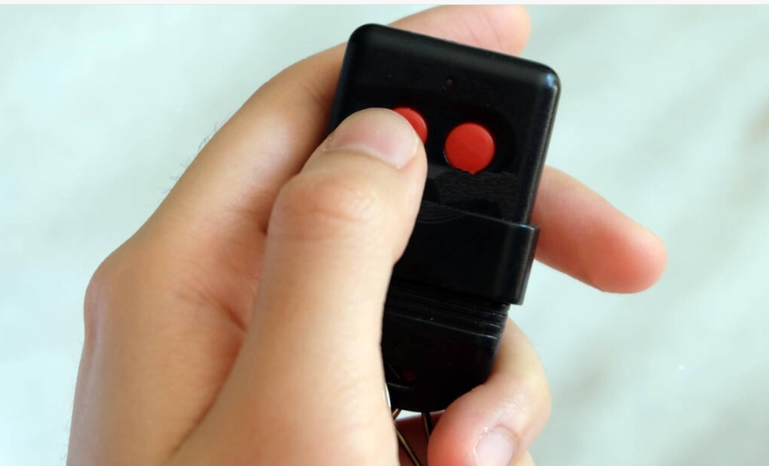
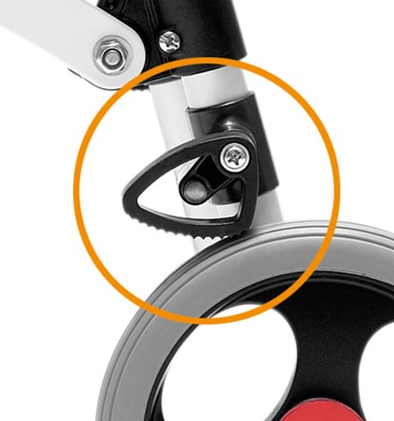
Who Cares?
7-year-old with cerebral palsy
Client Needs:
Safe and reliable
Can be activated from a distance
Is removable
Usable in common environments
Durable and long-lasting
Variable Braking

Slide 4
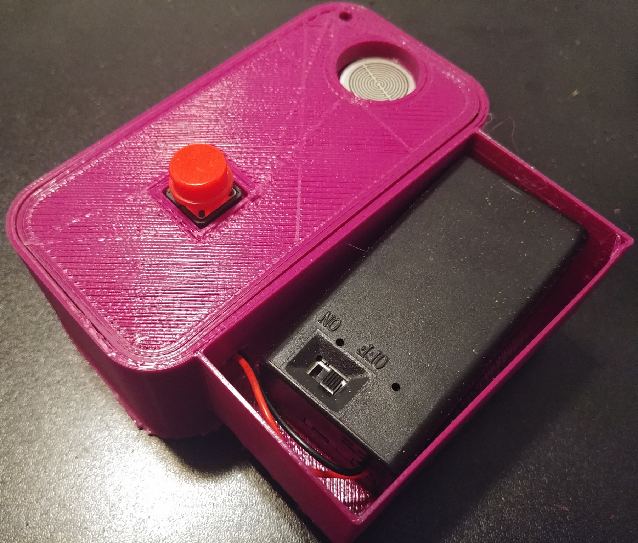
What Do We Have?
Best solution on the market!
Balances Independence and Safety
Clear, Simple, and Portable design.
← Prototype Remote
Control

Slide 5
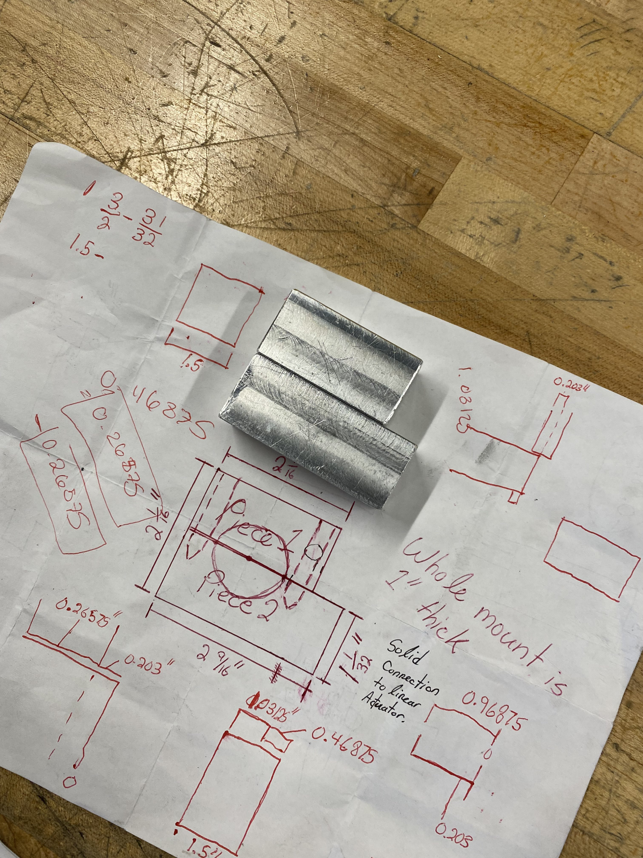
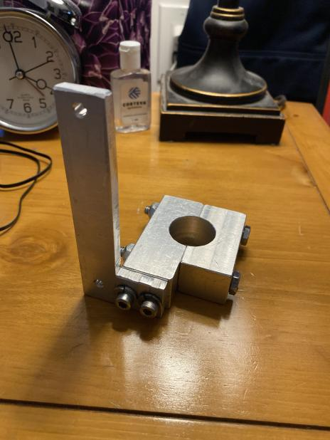
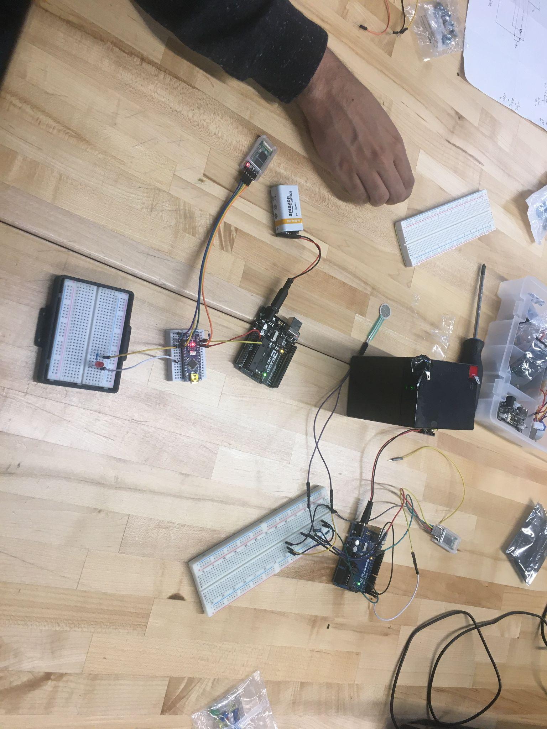
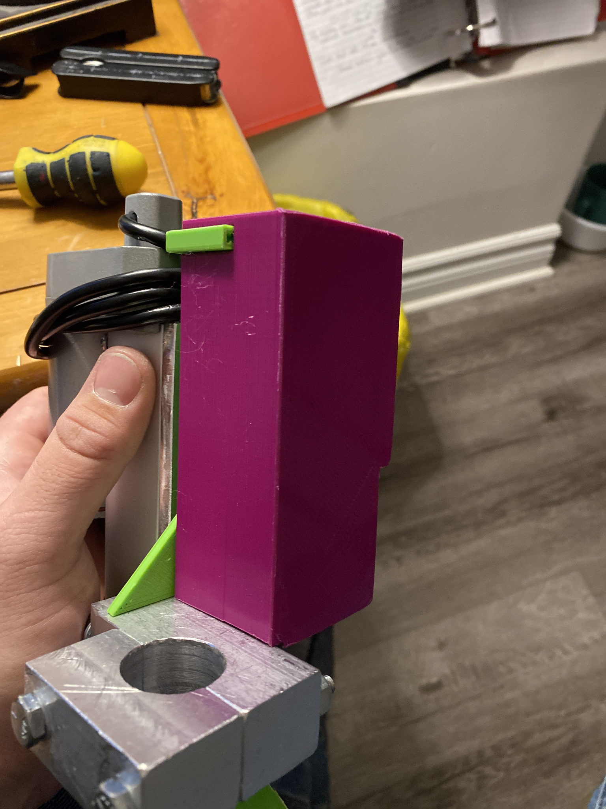
What Do We Have?
Our design is…
Safe
Simple To Use
Effective

Slide 6
Remote Braking System
Live Prototype Demonstration

Slide 7
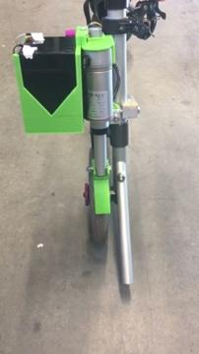
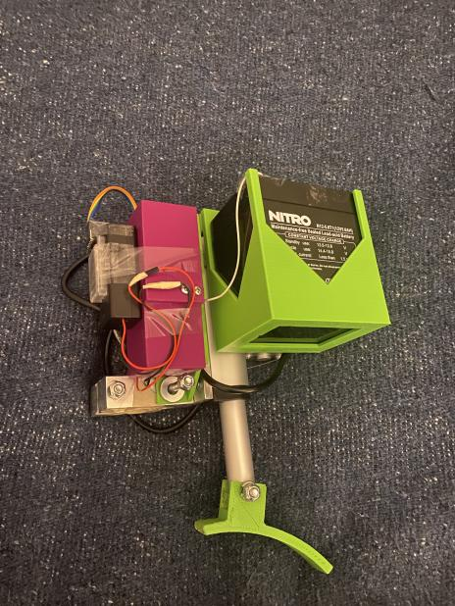
Demonstration
Clip demonstrates braking system applied to wheel itself.
In testing, the wheel has been shown to lose the ability to rotate on its axis, even with great force!

Slide 8
Thank You!

