Slide 1
The Heat Exchange Chamber
Group D1.4 - Team Rocket
Callum Bunston
Yousef Hemdan
Yassir Mechahouri
Rasheeq Mohammad
Yosr Ouali
Jiaho Sun
Notes:
Hello. We are team D1.4, and today we will be discussing with you our design for “The heat exchange chamber”.

Slide 2
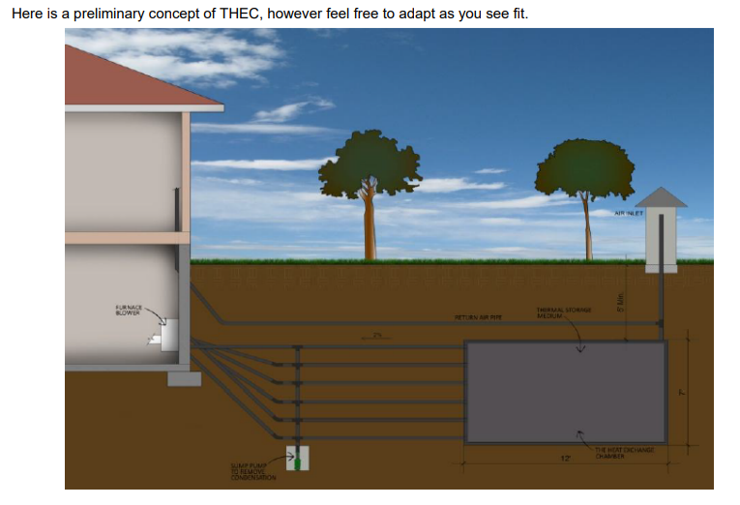
Background Information
The goal of the THEC system is to regulate the temperature in commercial or residential spaces. Unlike conventional HVAC systems, the specialty of this innovation is that the entire process is achieved through the natural geothermal exchange of energy with zero-emissions.
Notes:
To begin we will provide some brief background information for our project. We were tasked to design a zero emission HVAC system that extracts energy from the ground into buildings using no fossil fuel, refrigerant or heat pump. We are going to present to you the solution that we developed for this project.

Slide 3
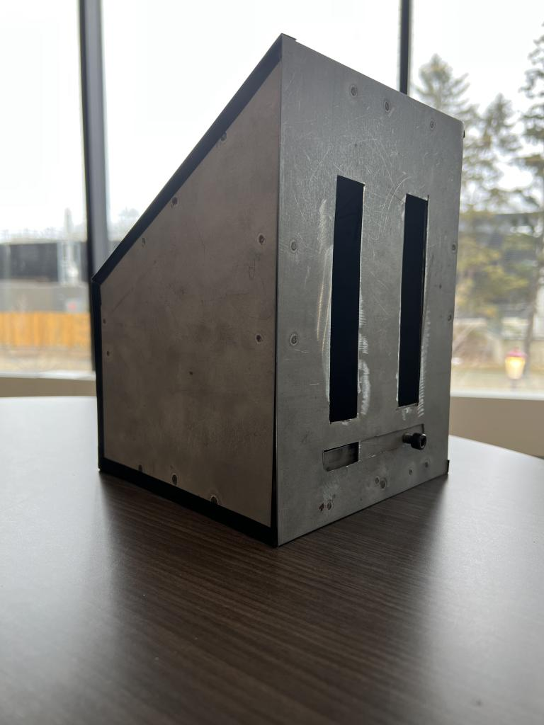
Air Inlet
Function:
Allows external air to enter into the system
Features:
Manual adjustable shutters
Slanted top
Easy to manufacture
Material:
Sheet metal
Notes:
To start we have the air inlet, an entry point for the fresh air from outside which is directly connected to the chamber box. It is a compact box made of sheet metal with an adjustable sliding door. The degree of openness can be adjusted to your convenience using the knob to have total control of the amount of air entering the system. The air inlet is designed with a slanted top that prevents any snow or water accumulation.

Slide 4
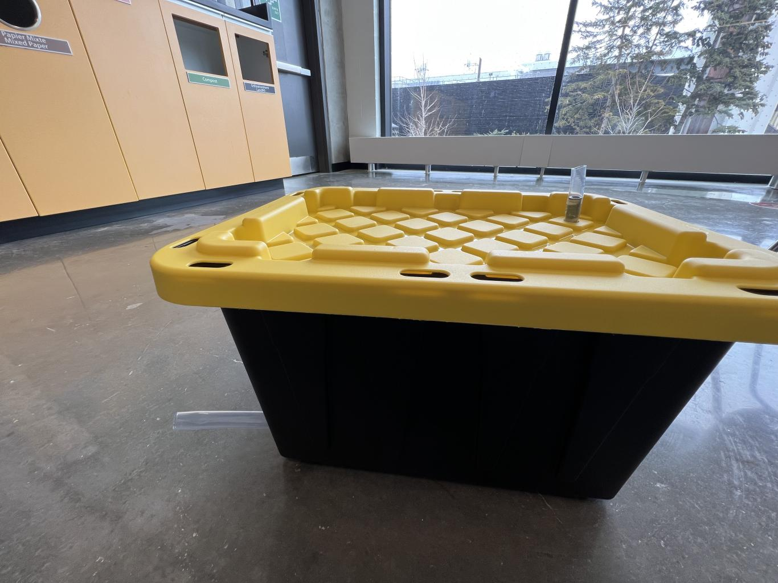
Chamber Box
Function: The chamber box contains the inner pipe and is buried 6ft underground. It is the intermediate between the air inlet and the furnace blower at the house.
Features:
Insulated
Light weight
Adjustable enclosure with lid
Material:
-Plastic box
Notes:
From here we move to the chamber box which receives the incoming air and performs the heat exchange for the system. We used a strong resealable plastic box to simulate our final product while being low cost and easy to work with. The chamber box is a secure insulator and permanent home for our piping, needing to be buried at least 6 ft underground and filled with a mixture of water and clay in our desired final design.

Slide 5
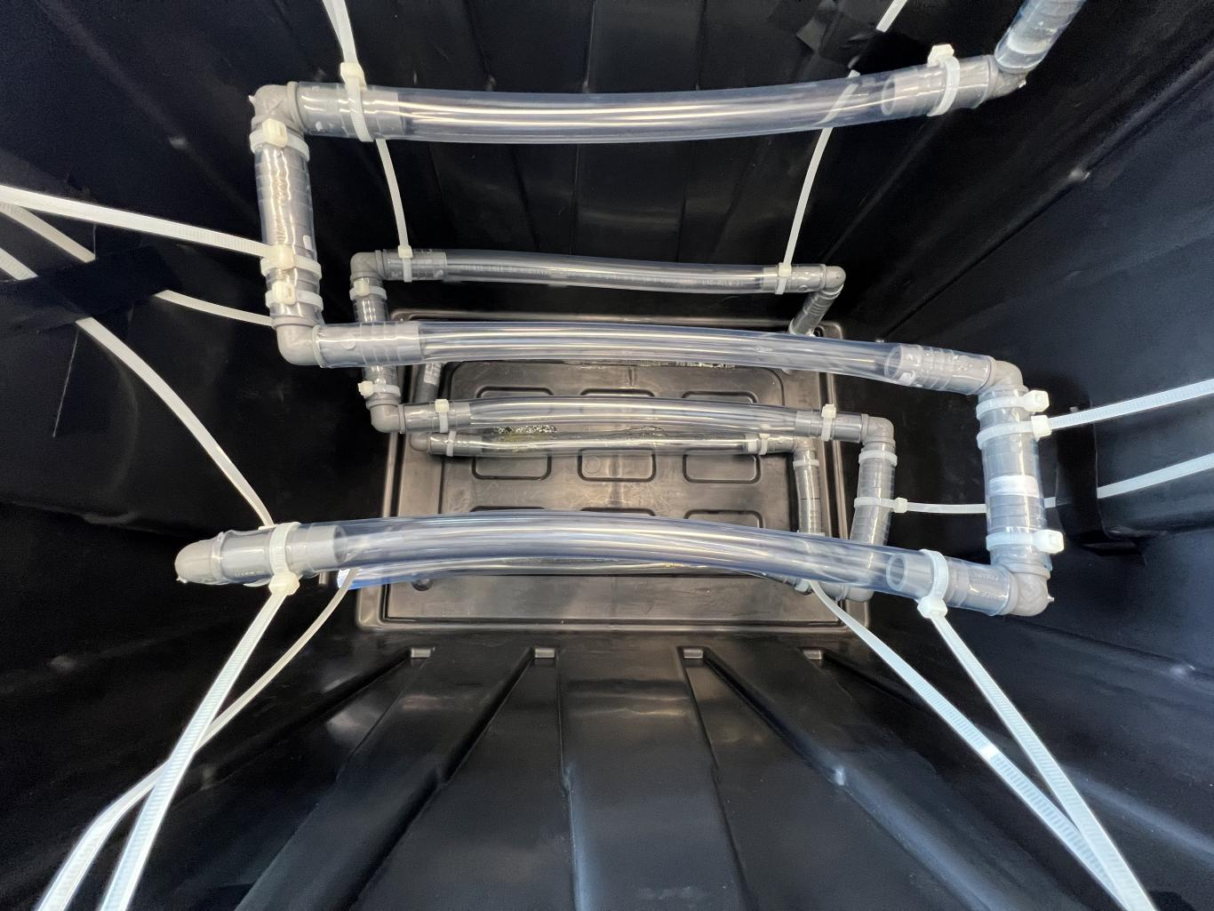
Inner Pipes
Function: Air circulation is enclosed inside the chamber box and heat exchange process occurs
Features:
Use of zip ties:
-Hold in position
-Prevent rotation of joints
-Seal leaks around the joints
Materials:
0.75” diameter vinyl pipe
17 elbow joints
18 zip ties
Notes:
Coming from the air inlet a series of pipes move the air through the chamber box. Through these layers of vinyl piping the heat exchange is also done, with the time spent within them, allowing the air to heat or cool. *Explain efficiency* As you can see we have also used zip ties to ensure tight seals on the pipes as well as suspending the pipes in the box. These again serve as cost effective alternatives to metal braces planned for our final design.

Slide 6
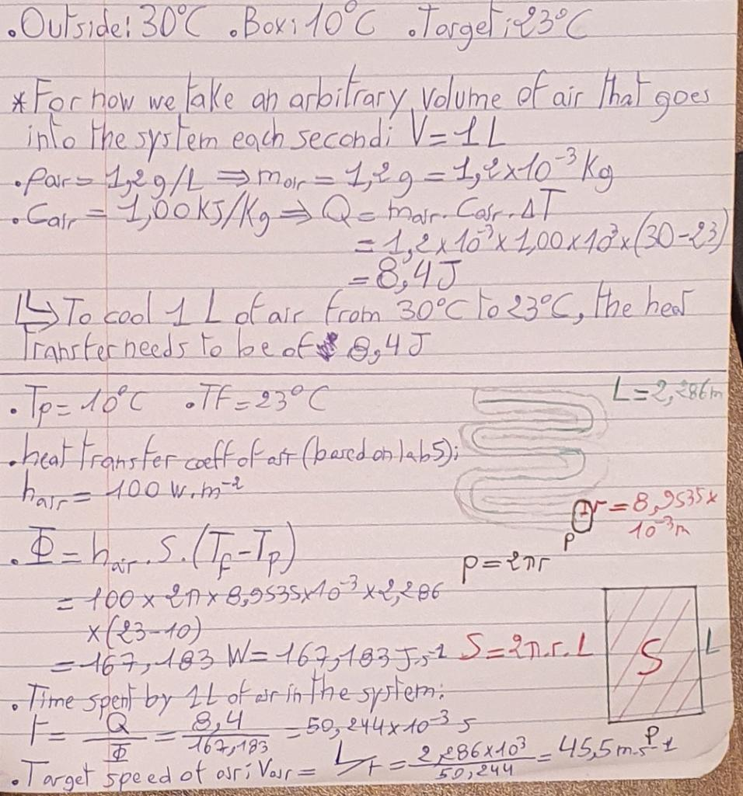
Heat Transfer
To cool from 30 C to 23 C:
Total length of pipes: 90 in
Diameter of pipes: 0.75 in
Heat transfer: 8.4 J/L of air
Air flow: 45.5 m/s
Notes:
Using the space available in the box, we determined the maximum length and diameter of pipes possible for our chamber box and calculated the best possible air flow and heat transfer rates. Based on our calculations, the prototype can achieve a heat transfer of 8.4 J/L of air with an airflow of 45.5 m/s, projected to have a net temperature change of 7 degrees. We decided that 3 layers of S shaped piping was the best formation to not only maximize the possible length but the best net outcome for these values.

Slide 7
Inner Pipes
Function: Air circulation is enclosed inside the chamber box and heat exchange process occurs
Features:
Use of zip ties:
-Hold in position
-Prevent rotation of joints
-Seal leaks around the joints
Materials:
0.75” diameter vinyl pipe
17 elbow joints
18 zip ties
Notes:
Coming from the air inlet a series of pipes move the air through the chamber box. Through these layers of vinyl piping the heat exchange is also done, with the time spent within them, allowing the air to heat or cool. These 3 layers of S shaped piping have been designed to optimize the air flow and temperature change of the system. *Explain efficiency* As you can see we have also used zip ties to ensure tight seals on the pipes as well as suspending the pipes in the box. These again serve as cost effective alternatives to metal braces planned for our final design.

Slide 8
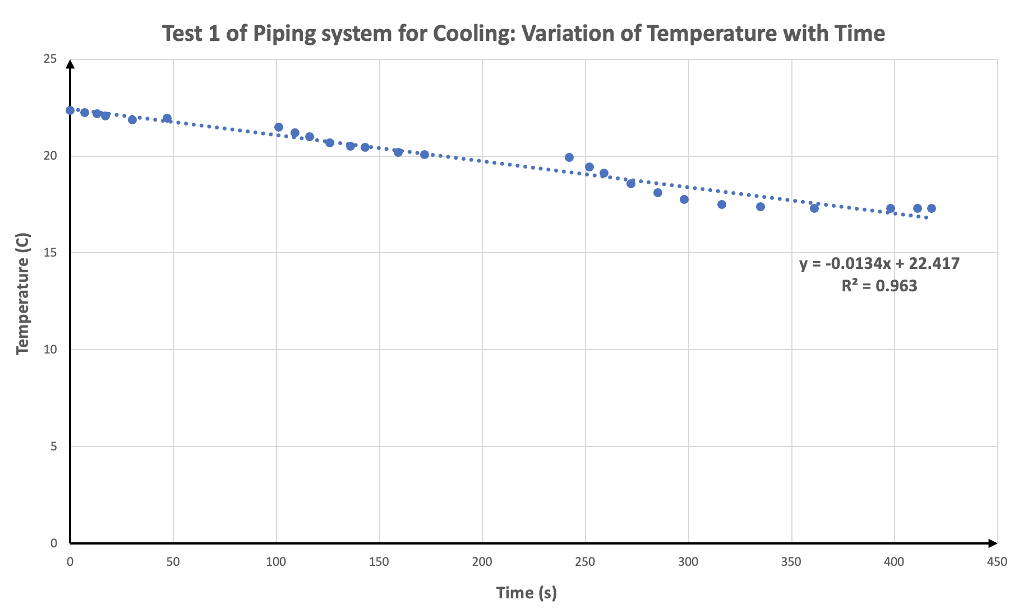
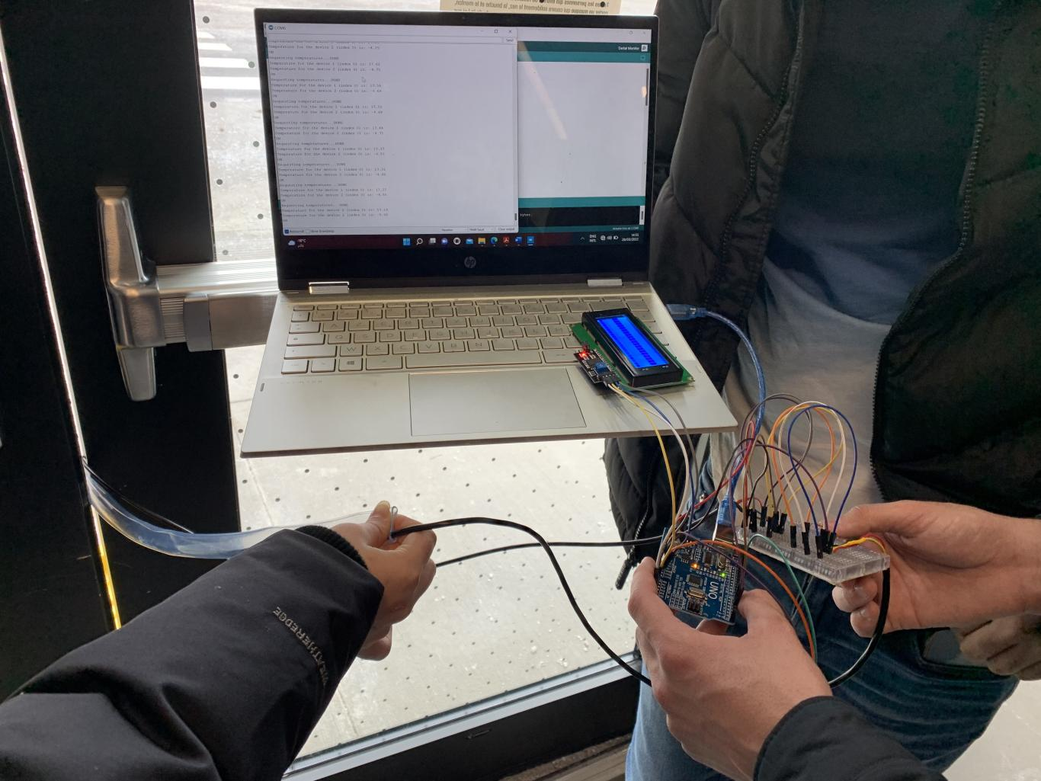
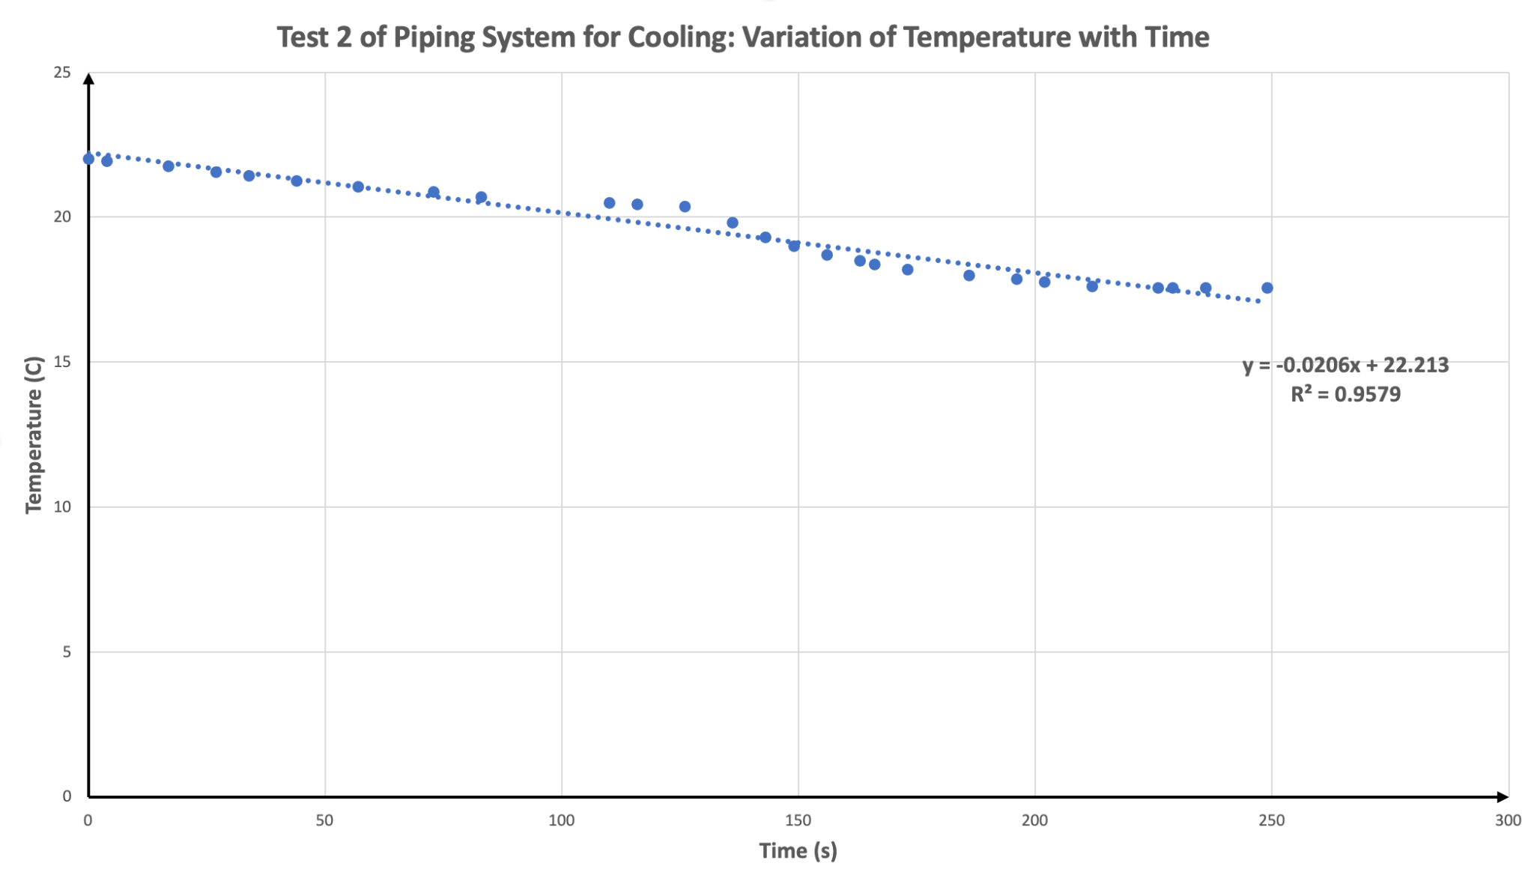
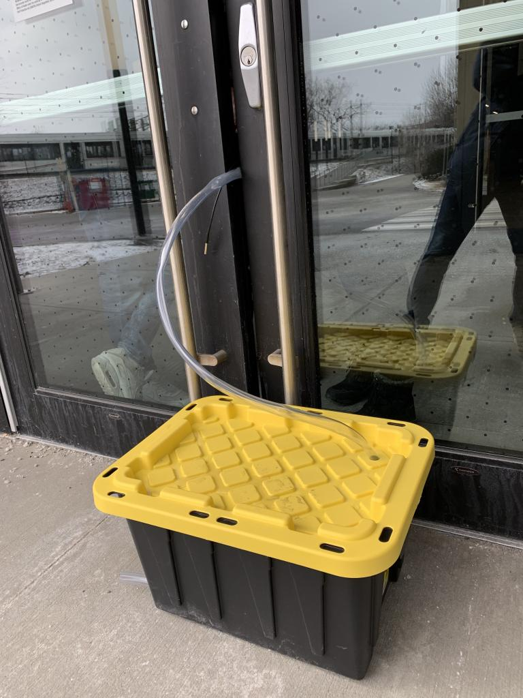
Efficiency
Notes:
From values gathered from testing we have been able to identify that these calculations do hold up. Using average results from both of our prototype tests we found that the air was able to cool down by around 5 degrees in 6 minutes. Although less than calculated, this is still an impressive change in a reasonable time. A very efficient design.

Slide 9
Outer Pipes
Function: Deliver the heated or cooled air to the furnace blower
Features:
-Network of pipes connecting from chamber box to house
-Connected to sump pump to remove condensation
Material:
-0.75” diameter vinyl pipe
-2 elbow joints
-2 T Joints
Notes:
As the air leaves the chamber box, it flows into our system of outer pipes.The main pipe splits into 2 and progresses towards the house. At this junction a sump pump is connected, which will capture the condensation in the pipes, and keep our system running nicely. This pump will be powered by the main electrical unit of the house.

Slide 10
Furnace Blower and Electronics
Temperature sensors
Potentiometer
Fan
LCD display
Notes:
From this piping division the air will continue towards its final step of the journey and will enter the furnace blower.The furnace blower is controlled by a connected electronic system that reads the inner and outer temperatures and blows in fresh air to reach a target temperature. This target temperature can be set using a potentiometer, connected to an arduino board and will be displayed on an attached LCD screen. This air blown in will balance out the temperature of the house and conclude the cycle of the system.

Slide 11
Questions???
Notes:
And this concludes our design explanation for our HVAC system. Thanks for listening,and know we open the floor to any Questions.

